Slide 1
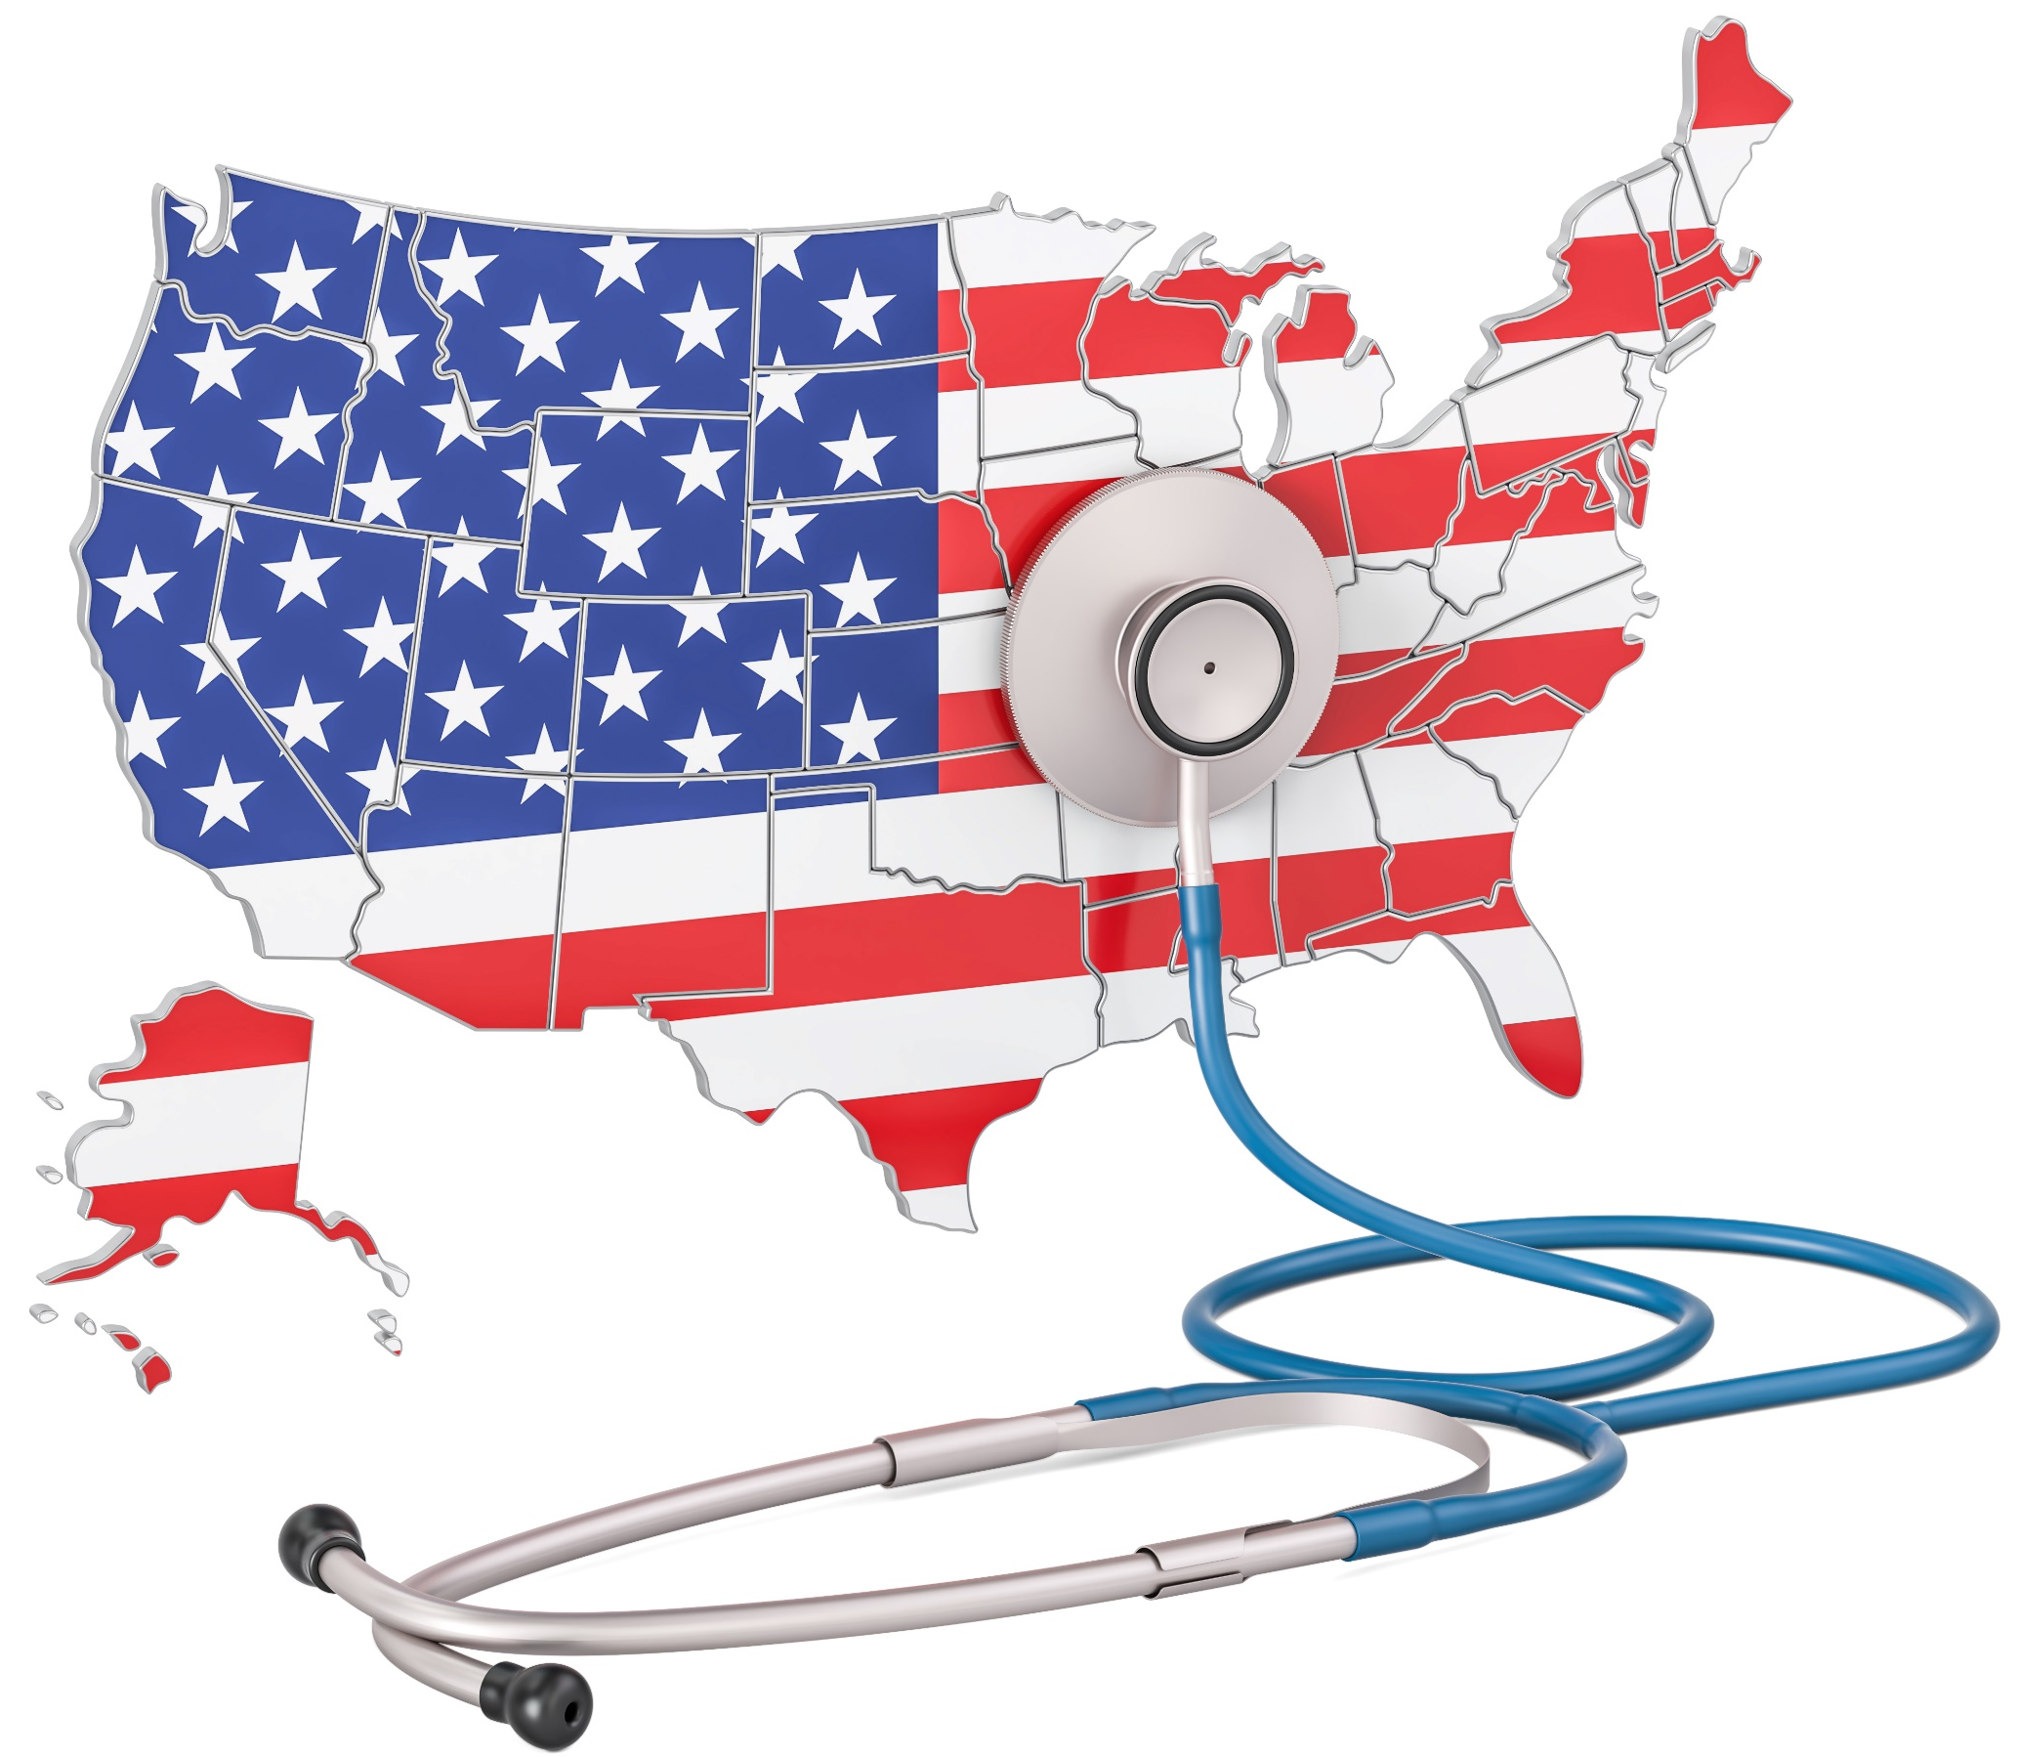
Employee Welfare Benefits:
New Compliance Developments and COVID-19 Updates
May 2021

Slide 2
Welcome and Introductions
Joe DiBella
Health and Benefit Consulting, EVP - Managing Director
Conner Strong & Buckelew | PERMA

Slide 3
Discussion Items
President Biden’s American Rescue Plan Act has been signed into law and is latest in series of COVID-19 related relief packages
COVID efforts in general over time with focus on provisions impacting group benefit plans
COBRA subsidy requirements
Options for cafeteria plans / Flexible Spending Accounts (FSAs)
Other new requirements and obligations for employers and plan sponsors
Latest development for employers related to COVID vaccines
Biden administration
Policy activities
Political dynamics
Future of Affordable Care Act (ACA)

Slide 4
COVID Relief: General Discussion

Slide 5
COVID-19 National Emergency
Impact of pandemic has been like nothing nation has ever experienced
COVID-19 declared National Emergency continues
Employers forced to make painful decisions related to layoffs, furloughs and reduction in worker hours
Unchartered territory with insurers, carriers, vaccines, work-life issues
Extension of various group health plan (GHP) related deadlines and timely elections/payments during continuing “Public Health Emergency”
PERMA and Conner Strong & Buckelew focus during crisis has been to:
Keep our clients informed with factual updates and information
Fiercely advocate for our clients to get assistance with markets
Provide assistance in any way possible to help customers make informed decisions

Slide 6
Multi-Phase COVID-19 Response
Initial support and vaccine development
Coronavirus Preparedness and Response Supplemental Appropriations Act - Became law 3/6/20
$8.3 billion in COVID-19 response funding for developing vaccine and preventing further spread of virus
Most dollars went to agencies within Department of Health and Human Services

Slide 7
Multi-Phase COVID-19 Response
Paid leave, unemployment, and food assistance
Families First Coronavirus Response Act (FFCRA) - Became law 3/18/20
Enacted when everything started shutting down in earnest and National Emergency was declared
$100 billion in worker assistance, including emergency paid sick leave, food assistance and unemployment payments
Required private health insurance plans and Medicare to cover COVID-19 testing.
Expanded unemployment insurance by $1 billion
Provided for paid sick leave at an employee’s full salary, up to $511 per day, and paid family leave at ⅔ of a parent’s usual salary
Special guidance subsequently issued:
IRS relief for Section 125 plans, health FSAs and DCAPs
IRS details on HDHPs
Agency FAQs on COVID-19 testing coverage and paid sick leave
Extended deadlines for participant elections (the “Outbreak Period” rules)
Extended ERISA notices and disclosures deadlines

Slide 8
Multi-Phase COVID-19 Response
Major economic stimulus package
Coronavirus Aid, Relief and Economic Security (CARES) Act - Became law 3/27/20
Major stimulus package ($2 trillion) – the BIG one
Direct (stimulus) payments to individuals ($1,200) and families ($2,400)
Established Paycheck Protection Program (PPP) for small businesses to receive forgivable government loans during shutdown, if they keep employees on payroll for eight weeks
Coverage for COVID-19 testing
HDHPs and telehealth services
Coverage for COVID-19 vaccine
Qualifying medical HSAs, HRAs and health FSAs
IRS website for employers to get information on tax credits and financial relief: https://www.irs.gov/coronavirus

Slide 9
Multi-Phase COVID-19 Response
Additional funding for small businesses, providers
Paycheck Protection Program and Health Care Enhancement Act - Became law 4/24/20
$310 billion for depleted PPP and additional funding for hospitals and testing
Unlike previous two laws, this one did not increase unemployment insurance funding or create any new mandates for businesses
About three-quarters of money went to replenish PPP, with rest going to public health measures such as virus testing and hospital funding

Slide 10
Multi-Phase COVID-19 Response
Additional funding for small businesses, testing, vaccines, providers
Consolidated Appropriations Act (CAA) 2021 - Became law 12/27/20
Longest Bill Ever Passed (signed by President Trump) - More pages than ACA
2ND round of PPP loans, $284 billion
$73 billion for vaccines, testing
$3 billion to providers, increased Medicare payments
Took effect in 2021
Flexibility rules for health and dependent care FSA plans (allows for optional carryover, grace period, spend down and FSA election changes for 2021 and 2022)
Prohibits group health plans from having “gag” clauses
Taking effect in 2022
The “no surprise billing” rules and requirements
Health care transparency (hospital price transparency rules were effective January 1, 2021)
Broker and consultant compensation disclosure
New mental health parity requirements (analysis required) related to non-quantitative treatment limitations (NQTLs)

Slide 11
Multi-Phase COVID-19 Response
Major stimulus package of $1.9T
American Rescue Plan Act (ARPA) - Became law 3/11/21
Builds upon CAA, CARES and FFCRA
Some have called ARPA the greatest expansion of welfare state since LBJ
Extends far beyond stimulus payments and unemployment benefits that have received most of attention
Expands child tax credit and Earned Income Tax Credit
Provides more generous support for child-care expenses
Bolstered ACA to tune of tens of billions of dollars through expansion of ACA coverage and subsidies
Subsequent Biden Executive Orders issued to allow for extended emergency COVID-related exchange special enrollment sign-up periods
Funding for vaccine distribution, testing
Incentives for states to expand Medicaid
Elimination of cap on Medicaid drug rebates in 2024
Most significantly for employer group plans – provides for 100% subsidy for COBRA benefits

Slide 12
American Rescue Plan Act

Slide 13
Expanded Employer Payroll Tax Credits
FFCRA required covered employers to provide paid sick and family leave for COVID-19-related reasons, but this requirement expired on 12/31/20
FFCRA provided covered private employers with refundable tax credits to reimburse them for the cost of providing paid sick and family leave to their employees
Then CAA extended availability of payroll tax credits through 3/31/21 (but did not extend FFCRA's mandate to provide leave), for employers who voluntarily provided leave to employees whose leave entitlements had not been exhausted by the 12/31/20 FFCRA sunset
Does the ARPA extend the availability of the credit?
Yes – ARPA extends the availability of the credit again from 4/1/21 to 9/30/21 and also expands the tax credits
Can public schools take the credit?
Yes, even though public schools (and other state and local government employers) were not able to take the credit under FFCRA state and local governments are now eligible for the credit under ARPA
See IRS website for information on tax credits and financial relief: https://www.irs.gov/coronavirus
Note - There are currently no federal leave laws that require paid leave (e.g., FMLA, ADA, USERRA do not require paid leave), but many state/local family/medical leave laws require paid leave (including for reasons related to COVID-19)

Slide 14
Temporary Expansion of Dependent Care Assistance Exclusion
Dependent care FSAs (DCAPs) are typically funded by employees on a salary reduction basis under a cafeteria plan
Normal annual limit permits an individual to exclude up to $5,000 from gross income under DCAP ($2,500 for married filing separately).
Not indexed annually for inflation like most benefit plan limits, so many have argued $5,000 is no longer sufficient amount (just ask anyone with a child in daycare)
ARPA increases limit to $10,500 ($5,250 for married filing separately), but only for taxable years beginning in 2021
Employers who sponsor a DCAP can voluntarily choose to adopt provision (it is not required) and increase available election amount for 2021 under DCAP
Participants can be allowed to change DCAP elections prospectively in 2021, but plan amendment must be adopted by last day of plan year to implement
Employers who want to offer increased DCAP election limit for 2021 should
Work with FSA administrators to adjust contribution limits and reimbursements
Communicate ability to increase elections to employees as soon as possible
Ensure plan is amended by end of 2021 plan year to allow for increased amount

Slide 15
100% COBRA Subsidy
ARPA provides for 100% federal subsidy for COBRA premiums due to cover certain “qualified beneficiaries” or QBs (called Assistance Eligible Individuals or AEIs) during any period of COBRA coverage for six-month period beginning 4/1/21 and ending 9/30/21
Subsidy will cover full COBRA cost (100%) during subsidy period for medical, dental, and vision (but not health FSAs)
Subsidy is applied at any coverage level (e.g., single or family)
AEI must elect COBRA during subsidy period due to COBRA qualified event (QE) of involuntary termination of employment or reduction in hours
Not first time government has funded a COBRA subsidy

Slide 16
But First……the Outbreak Period (“OP”)
Numerous Group Health Plan participant deadlines that would have expired are extended during “Outbreak Period” or OP
Rules automatically “freeze” certain timely deadlines for duration of OP
Suspends HIPAA special enrollment notice period
Extends good faith time to provide ERISA required notifications
Suspends benefit claim periods, deadline to provide COBRA elections to QBs, and COBRA elections and payments
OP extensions mandatory for ERISA group health plans (GHPs) – strongly encouraged for non-ERISA plans
Compare to COBRA subsidy rules which are mandatory for all plans
OP is from 3/1/20 to 60 days after end of National Emergency (NE)
OP pause period cannot extend beyond one year for a QB (applied on individual by individual basis)
But tolling period may end earlier than one year once NE ends (so if NE ends 5/1/21, all COBRA election periods end 6/29/21)
All applicable periods automatically resume once OP ends
Deadlines ending before 3/1/20 are NOT affected/extended

Slide 17
COBRA Subsidy – Assistance Eligible Employee (AEI)
Any COBRA QB - employees and their families – can be an AEI and can elect COBRA during subsidy period due to a qualifying event (QE) of involuntary termination of employment or reduction in hours
Subsidy is NOT available for
someone who voluntary terminates employment
someone whose employment was involuntarily terminated for “gross misconduct” (they technically do not have a COBRA QE, and, therefore, would not be subsidy-eligible)
other QEs (employees who lose coverage due to voluntarily ending employment, divorce, dependent aging out, etc.)
Subsidy IS potentially available for anyone entitled to COBRA due to involuntary termination of employment or reduction in hours (for any reason)
Determination of whether a termination is involuntary is based on all facts and circumstances
To be eligible individual must elect COBRA coverage and send in special form to request AEI status
The individual cannot have another offer of employer-sponsored coverage or access to Medicare coverage

Slide 18
COBRA Subsidy – Notices (new COBRA QBs)
COBRA subsidy creates new notice requirements (different from the basic COBRA general notice requirement)
DOL Model Notices are available (not mandated and can be modified as long as final notices include required detail)
Plans are encouraged to use model notices to meet their notice obligations
The model notices require individual customization and cannot be used without that customization
For any QB who loses coverage and is offered COBRA beginning at some point between 4/1/21-9/30/21 (Subsidy Period) – use Model ARP General Notice and COBRA Continuation Coverage Election Notice: MS Word
Must include Summary of COBRA Premium Assistance Provisions under the American Rescue Plan Act of 2021: MS Word (includes forms necessary for establishing eligibility for subsidy)
Notices may be provided as supplement to standard COBRA election notice or terms may be incorporated into COBRA election notice
Notice must describe subsidy and ability to enroll in different coverage option (if so permitted by employer)
Provide Notice at time that usual COBRA election notices are provided
AEIs must make an election for COBRA coverage to be in place during Subsidy Period

Slide 19
COBRA Subsidy – Notices (QBs prior to 4/1/21)
For all employees who experienced an involuntary termination or reduction in hours prior to 4/1/21 (beginning of Subsidy Period) and are still within 18-month COBRA period in April 2021 (whether they had elected, declined, or elected but discontinued coverage) - use Model Notice in Connection with Extended Election Period: MS Word
Applies generally to any involuntary termination or reduction in hours occurring back to October 2019, where 18 month period would begin 11/1/19 (employers need to identify AEIs and inform COBRA administrators)
Must include Summary of COBRA Premium Assistance Provisions under the American Rescue Plan Act of 2021: MS Word (includes forms necessary for establishing eligibility for subsidy)
Notice must describe subsidy and ability to enroll in a different coverage option (if so permitted by employer)
Notice must be provided by 5/31/21
Individuals will then have 60 days following date that Notice is provided to elect COBRA and subsidized coverage
AEIs do not have to pay retroactive premiums back to date they originally lost coverage and became eligible for COBRA
QBs still have option to wait until end of Outbreak Period deadline extension to make their COBRA election for coverage back to original QE, but to take advantage of subsidy, they must make their COBRA election/identify as an AEI within the 60 day special election period

Slide 20
COBRA Subsidy – Notices (Subsidy expiration)
Notice must be provided to inform AEIs when their subsidy will expire, and that individual may be eligible for unsubsidized COBRA, Medicaid or the Health Insurance Marketplace - see Model Notice of Expiration of Premium Assistance: MS Word:
Subsidy will end on earliest of (i) 9/30/21, (ii) expiration of AEI’s ordinary COBRA coverage (typically 18 months from date of involuntary termination or reduction in hours), or (iii) date AEI becomes eligible for coverage under another group health plan or Medicare
Notice must be provided no more than 45 days and no fewer than 15 days before expiration date

Slide 21
COBRA Subsidy – Premium Payment and Tax Credit
AEI will pay zero dollars during subsidy period and employer will pay full premium (100%) or employer will cover AEIs at no cost under self-insured plan
Subsidy amounts are not counted in gross income for recipient
Eligible individuals who already made payment for subsidy period should be reimbursed within 60 days of their premium payment
Employers will then recover premiums (including 2% administrative fee) through a payroll tax credit (similar to how employers recovered mandatory FFCRA paid leave costs)
Pending IRS rules for claiming credits and advance payments

Slide 22
COVID-19 Vaccine Employer/Employee Issues

Slide 23
Concerns Related to COVID-19 Vaccine
Many Americans scared of COVID-19 vaccine
According to CDC, fewer than half of Americans get annual seasonal flu shot, even though inexpensive and often free, widely available and requires single dose
Flu vaccination coverage for all age groups (except children under 2) falls below national target of 70%
Among adults 18 and older it is 43.3%
For adults 18-49, vaccination coverage in general is 33.6%, the lowest among any age group
What is level of COVID-19 vaccination that would provide protection for population at-large, including those who are unable to take vaccine for medical reasons?
Per infectious-disease expert Dr. Anthony Fauci, at least 75% of population will need to be vaccinated for country to return to normal
Some suggest number may be closer to 40-50%

Slide 24
Benefits of Workplace Vaccination
Benefits to Employers
Reduces cost by decreasing time missed from work to get vaccinated
Reduces cost by reducing absences due to illness, resulting in improved productivity
Vaccination often already covered under employee health plans
Improves morale
Benefits to Employees
Reduces absences due to sickness and doctor visits
Improves health
Convenience
Improves morale
Benefits will vary based on investment by employers in championing vaccination and number of employees vaccinated

Slide 25
Promoting Flu Vaccines in Workplace
Many employers take action to keep their workplace healthy during seasonal flu season
Offering free on-site flu vaccinations at business locations
If on-site flu vaccines not available, encourage employees to seek flu vaccination in community
Make annual flu vaccinations part of workplace wellness program
Offers many benefits to employer and employees
See more from CDC on “Promoting Vaccination in the Workplace”
https://www.cdc.gov/flu/business/promoting-vaccines-workplace.htm

Slide 26
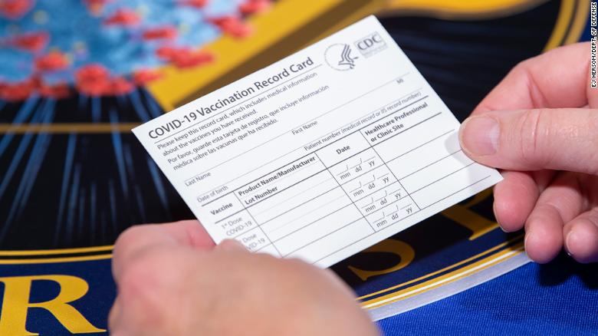
Employee Education Regarding COVID-19 Vaccine
Employers/plan sponsors should encourage employees/members to obtain COVID-19 vaccine
Many carriers developing educational materials that can be used to educate employees/members on effectiveness and safety of COVID-19 vaccine and where to obtain vaccine
What happens after an employee gets COVID-19 vaccine?
Mild side effects possible (pain at injection site, fatigue, aching muscles)
Possible long term effects not known
Vaccination cards issued (provides detail on shots received and when
second dose is due)
Continue practicing social distancing and continue wearing
masks when in public
CDC resources useful for communicating with plan enrollees
website provides access to information about who gets vaccinated first, what to expect at the vaccine appointment, benefits of getting vaccinated, the safety of vaccines, and more

Slide 27
Can Employer Mandate COVID-19 Vaccine?
Short answer appears to be yes (with caution) according to some reputable employment lawyers
Legal bar for mandatory vaccinations apparently requires showing “strong business necessity” for mandated vaccine – but many questions remain
Is preventing a deadly disaster a business necessity?
Could employer punish or terminate workers who refuse to get vaccine - since refusal could endanger customers/coworkers?
Case for mandatory vaccines will vary depending on type of work someone does (employee works in busy store/crowded office vs. someone mostly working by themselves)
Some workers will demand exemption on medical/religious
Employees who refuse to get vaccinated on religious grounds may present particular challenge

Slide 28
Workers Compensation and COVID-19 Vaccine
Would it be a workers compensation claim if employer required vaccine and then employee had adverse reaction? Answer - Maybe
Compensability for adverse events from vaccine is highly fact and state specific – consult with your RM
Some states have found adverse reactions to employer offered or mandated flu or other vaccines to be compensable
Some factors that seem to matter include
Where was vaccine administered?
Was it mandatory or strongly encouraged?
Did employee receive on a work day?
How did it benefit employer?
Did employer have business reason for wanting employees to get vaccinated?

Slide 29
COVID-19 Vaccine How Costs Are Covered

Slide 30
How Much Does the COVID-19 Vaccine Cost?
COVID-19 vaccine itself free to all Americans
FUTURE COST impact of COVID
Federal government is covering cost of COVID-19 vaccine serum (free to all Americans)
Vaccine doses given to Americans at no cost (vaccine providers will be able to charge administration fees for giving or administering)
Federal government also covered cost to develop/manufacture vaccine serum
More than $9 billion to develop and manufacture candidate vaccines
Another $2.5 billion earmarked for vials to store vaccines, syringes to deliver them, and on efforts to ramp up manufacturing and capacity
CMS committed to providing COVID-19 vaccine for every adult in America who wants to be vaccinated
FDA authorized three safe and effective vaccines for emergency use, and federal agencies supporting clinical trials of additional vaccines
FDA has now authorized Pfizer Vaccine for emergency use in adolescents 12 and older; Advisory Committee on Immunization Practices is meeting 5/12/21 to discuss recommendation for use in persons aged 12 and older

Slide 31
Who Pays for COVID-19 Vaccine Administration
No member will be charged for COVID-19 vaccine or administration
Vaccine providers able to charge administration fees for giving or administering injection/shot
Health care providers who administer vaccine can get fee reimbursed (either by patient’s insurance or, in case of uninsured patients, by governmental program for uninsured)
Medicare’s published Fee for Service rates for vaccine administration used as guideline for reimbursement rate by many insurance companies
As of 3/15/21, the national average payment rate for is $40 to administer each dose
Represents increase from approximately $28 to $40 for the administration of single-dose vaccines, and an increase from approximately $45 to $80 for the administration of COVID-19 vaccines requiring two doses
Rates apply to vaccine administration, whether covered under medical or pharmacy benefit
Free coverage of preventive services required under employer plans (including COVID-19 vaccines)
Non-grandfathered plans must cover recommended preventive health services without cost-sharing (ACA mandate) during public health emergency (PHE) and likely beyond as well

Slide 32
Current and Future Obligations

Slide 33
What Continues
Current and historic compliance obligations continue
ACA and other limits and requirements
Cafeteria plan rules
HIPAA Special Enrollment election rules (see also temporary Outbreak Period rules)
HIPAA and ACA wellness rules and limits (see also new proposed wellness regulations)
Internal Revenue Code imputed income and benefit taxation rules
HIPAA privacy and security rules
COBRA rules (see also temporary Outbreak Period rules)
PCORI fees
Medicare Secondary Payer and Medicare Part D notices
IRS Form W-2 Reporting of the Cost of Employer-Sponsored Group Health Plan Coverage
SBC, SPD, SMMs, plan documents,

Slide 34
What Continues
HIPAA privacy and security rules – may see switch from health care provider focus to more focus on health plans
Expanded rule for qualified medical expenses under CARES Act – account based plan distributions for qualified medical expenses no longer required to be limited to medicines and drugs that are prescribed (includes feminine care products)
ACA mandate and reporting
Timing issues (most recent reporting due in March 2021) and new codes (conditional spousal coverage and ICHRAs)
Enforcement (likely more under Biden administration)
Penalty assessments for coverage failures and for late or incorrect filings
Record retention important to demonstrate compliance with requirements and defend against penalty
State mandates and reporting
States with individual mandates/penalties: Some states (CA, DC, MA, NJ, RI and VT) have their own statewide individual mandate/penalties, and other states are considering a mandate (HI, WA, CT, MN and MD)
Employers may want to track developments in this area to be prepared to comply with any state reporting obligations regarding their individual mandates (see ACA vendors for assistance)

Slide 35
What Won’t Continue
Limited regulation/guidance as existed during Trump administration – much more regulation expected under Biden administration
Cafeteria plan election change flexibility from 2020 rules ended 12/31/20 (new optional FSA flexibility for 2021 and 2022 only)
FFCRA paid sick/expanded family leave expired 12/31/20 (tax benefits continue through September 2021 under ARPA)
Extension of various group health plan (GHP) related deadlines and timely elections/payments
“Public Health Emergency” or PHE (likely extended through the end of 2021) extends various GHP related deadlines (e.g., PHE will determine period of time during which GHPs and insurers must pay for COVID-19 tests and related services without charging cost sharing; and non-grandfathered plans must cover vaccines in network as a preventive benefit, but during PHE must also cover vaccines on an out-of-network basis)
By contrast, the “National Emergency” continues - and therefore numerous GHP participant deadlines that would have expired are extended during “outbreak period” set to end 60 days after end of National Emergency
Rules “freeze” certain timely deadlines for duration of outbreak period (for COBRA elections/payment, HIPAA Special Enrollment elections, claims deadline for benefits, and good faith furnishing of notices, disclosures, or documents that would otherwise have to be furnished during outbreak period)

Slide 36
What Might Not Continue
Certain regulations not finalized during Trump administration (e.g., wellness regulations)
President Biden ordered freeze on new or pending rules issued by Trump administration
Freeze prevents agencies from implementing rules until Biden administration has chance to review them
Limited enforcement of existing rules (Biden administration likely to increase enforcement efforts)
Two new HRAs that both small and large employers can implement – Individual Coverage HRAs (“ICHRAs”) and Excepted Benefit HRAs (“EBHRAs”)
Biden administration may view using HRAs to buy individual policies as disfavored

Slide 37
What Might Be Coming
U.S. Supreme Court review of case challenging entire ACA as unconstitutional as result of repeal of individual mandate tax – decision expected by June 2021
Plan design changes due to discrimination in provision of health services under employer plans; e.g., under Section 1557 of ACA (transgender participants), Title VII of the Civil Rights Act of 1964 (LGBTQ employees and disability benefits due to gender dysphoria), and state insurance laws (contraceptive coverage).
New wellness regulations –
Proposed rules would significantly limit level of incentives in many types of wellness programs
Employers not required to comply until after finalized
Additional changes expected from EEOC after comments received and changes also expected under Biden administration that could impact final approach
Electronic distribution rules – hopeful for updates to existing electronic distribution rules for health and welfare plans that might provide some forms of relief

Slide 38
What is Coming
Healthcare transparency
Prohibition on “gag” clauses
MHPA analysis and reporting
Broker and consultant compensation disclosure and reporting
Annual reporting on plan medical costs and pharmacy spend
The “no surprise billing” rules and requirements

Slide 39
Biden Administration – What’s Next

Slide 40
Affordable Care Act (ACA) – Coming Next?
U.S. Supreme Court review of case challenging entire ACA as unconstitutional as result of repeal of individual mandate tax – decision expected by June 2021
New ACA subsidies expire at end of 2022, setting up figurative cliff in which premiums would go back up if Congress does not act
Democrats could use moment to make those changes permanent
Alternatively legislators could find themselves balking at price tag – making ACA subsidies permanent would most likely cost hundreds of billions

Slide 41
What’s Next
Industry will continue to change over time (and we will follow, report and develop solutions as changes occur)
More COVID-19 relief in 2021? Next wave of new pandemic response proposals
Extension of COBRA subsidies beyond September?
More FSA relief?
More guidance addressing return-to-work employer initiatives? and possible extension of first federal paid leave requirement into 2021?
Offer a public option, administered by Medicare, intended to be relatively low cost?
Revive individual mandate by increasing penalty?
Provide unrestricted opt-out from an employer health plan?
Taxing employee benefits?
Changes to ACA employer mandate requirements – possible employer reporting relief?
Final wellness EEOC rules?
Electronic distribution rules – hopeful for updates to existing electronic distribution rules for health and welfare plans that might provide some forms of relief?

Slide 42
New Administration - Policy Activity and Political Dynamics
Policy Activity
Expecting policy period that will be extraordinarily consequential for employee benefit plans
As Biden proposal proceeds through Congress, possible that scope of proposed relief package could expand further
Biden administration is reexamining regulatory activity of Trump administration
On Day One, Biden administration issued moratorium on recent/pending regulations (not clear which regulatory projects will ultimately be pulled back)
Political Dynamics
Cross-party relationships are extremely fragile
Razor-thin Democratic majorities in Senate and House of Representatives will complicate President Biden’s opportunities to move his agenda forward
Assuming bipartisan support is not forthcoming, Democrats likely will seek to enact legislation in one of two ways-
Could seek to change Senate rules to abolish filibuster
More likely, will attach priorities to annual budget reconciliation legislation (requires only simple majority to pass)
Used by Democrats in 2010 to enact ACA on party-line vote and by Republicans in 2017 to pass Tax Cuts and Jobs Act also along strict party lines
All provisions of budget measure must have federal revenue impact (provides some guardrails around what can be enacted)
Courts may serve as brake on Democratic policies and further state activity will be byproduct of congressional gridlock

Slide 43
2021 Trends to Watch
Proliferation of Virtual Care
Exploded in 2020, and will continue to grow in 2021
Expanded virtual options/improved availability (to include weight management, care management for chronic conditions such as diabetes and cardiovascular disease, prenatal care, and musculoskeletal care management/physical therapy)
More attention to evaluation of quality, outcomes, effectiveness, patient experience and cost of virtual care options and innovations, as well as appropriateness of virtual versus in-person care for specific services
Support for Role of Employers and Coverage under Health Plans
Support for employer vaccination efforts and robust COVID-19 testing and contact tracing capabilities
Changes to Health Care Delivery
COVID-19 resulted in changes in healthcare delivery (moving lower acuity care out of hospitals to free up beds for patients with COVID-19 and other serious conditions) and slowed expansion of alternative payment and delivery models because of pandemic
Employers and plans may redouble efforts in 2021 to drive improvements in quality and value
Interest in Paid Leave
Short term federal legislation to expand access to paid family and medical leave and paid sick leave provides opportunity for uniformity for nationwide workplaces and works toward leveraging private sector solutions
Focus on Mental Health and Emotional Well-being
Employers have had to focus more than ever on employee stress and anxiety, and other serious mental illness.
Offers of virtual counseling and integration of EAPs and mental health benefits, place mental health on par with other medical conditions

Slide 44
COVID-19 Helpful Resource Links
American Rescue Plan Act
Conner Strong COVID-19 Resource page
CDC COVID-19 page
DOL FMLA FLSA COVID-19 page
EEOC: What You Should Know
IRS COVID-19 page
NJ Labor Coronavirus page
NY Labor Coronavirus page
OSHA COVID-19 page
Small Business Assoc (SBA) COVID-19 page
World Health Organization page
*to open links above and elsewhere in PowerPoint, right click on item and click on “open hyperlink”

Slide 45
THANK YOU
Questions? Comments?

