Slide 1
The Power of Collaboration – Part 1
Paul J. Shives, VP and Director of Safety Services

Slide 2


The Power of Collaboration

Slide 3

Our Agenda for Part One
Insurance & Indemnification
Creating and Managing a Joint Insurance Fund
Employee Safety
Worker’s Compensation
The Tort Claims Act (Title 59)
Employment Practices Liability
Americans with Disabilities Act (ADA)

Slide 4

Insurance and Indemnification

Slide 5
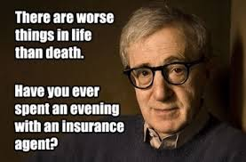
Insurance and Indemnification

Slide 6





Personal Insurance Most of Us Need

Slide 7
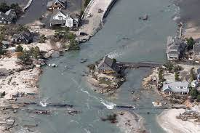
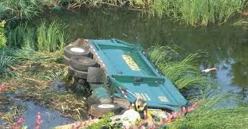
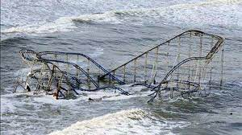
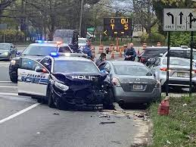


Insurance and Indemnification

Slide 8

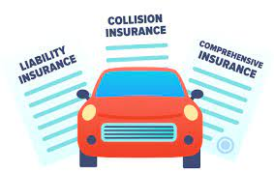
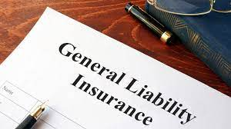
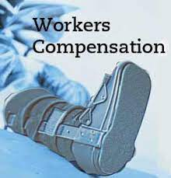
Insurance and Indemnification
Regardless of who the insured is (i.e., a municipal entity, private commercial entity or individuals or families), insurance is about the sharing of risk.

Slide 9

Insurance as a “Layer Cake”
First Layer: How much do you want to retain yourself? (aka the deductible and co-insurance)
Second Layer: Basic layer of insurance coverage (commercial insurance or Self Insurance)
Third and Beyond Layers: Excess Insurance, usually commercial insurance

Slide 10

Types of Insurance Coverage
Worker’s Compensation
  Coverage is mandated by law for on-the-job injuries or illness on a “no-fault” basis
  Represents half the cost of property-casualty insurance for typical local government entities
  Will cover this in more detail later

Slide 11

Type of Insurance Coverage
Automobile Insurance – damage to auto, property, and injuries; No-Fault in NJ.
Property Insurance
  Approximately 10% of the cost of property-casualty insurance for local government entities.
  Most common perils covered:
    Fire
    Flood, windstorm, lightning & other weather-related events
    Motor vehicle collisions
    Failure of mechanical & electrical equipment

Slide 12
Type of Insurance Coverage
Property Insurance (Continued)
  Perils NOT covered:
    Flood within flood hazard areas (Covered by Flood Ins.)
    Wear and tear, along with faulty construction
    Pollution, disease and pathogens (EJIF)
    Theft by officials, employees or volunteers (Crime Policies)
  Types of Property NOT covered:
    Land, beaches & related improvements, including sidewalks, roadways and greenery
    Sanitary and storm sewers
    Watercraft and aircraft
    Personal property or vehicles owned by employees
    Electronic data and software
    Money and securities

Slide 13

Type of Insurance Coverage
Property Insurance (Continued)
  Coverage Considerations:
    Natural Catastrophes
    Vehicles Not Covered
    Boiler and Machinery
    Newly Acquired Property
    Valuations
    Historic Buildings
    Errors in Valuations
    Pollution

Slide 14

Property Insurance Coverage
Property Insurance
$125,000,000 Limit
Zurich North America
$900,000 MEL or CEL Deductible
$100,000 JIF Deductible
Member Deductible

Slide 15

Type of Insurance Coverage
Crime Policies
  Covers the exclusions under the property policies for monies and securities as well as theft by officials, employees and volunteers.
  Statutory Bonds – the faithful performance bond required by the Treasurer or CFO, Tax Collector, Utility Collector. Levels of bonding are set out in State regulation in N.J.A.C. 5:30-8. The MEL requires the following:
    Completed application
    Credit score of 600 or above
    No pending bankruptcies, insolvencies or similar financial condition
    Completed FCRA Consumer Disclosure and Authorization form.
    There is an appeal process for those employees who are denied.

Slide 16

Liability Coverage
Liability Insurance Coverage
  40% of the costs of property-casualty insurance for typical local government entities
Liability Insurance (Continued)
  Typically consists of eight (8) primary insurance policies
    General Liability
    Auto Liability
    Police Professional Liability
    Public Officials Liability
    Employment Practices Liability
    Environmental Liability
    Cyber Liability
    Aircraft Liability

Slide 17

Liability Coverage
“Other Insurance” exclusion eliminates duplication of insurance
Does not cover liabilities under contract unless specifically named
Usually does NOT cover lawsuits seeking injunctive relief
Does cover defamation lawsuits EXCEPT between officials, employees, or volunteers.
Insured has a duty to cooperate in defending the claim. Failure to do so may nullify the policy.
Liability policies DO NOT cover punitive damages
In addition to paying judgements and settlements, liability insurance also pays the cost of defense.

Slide 18
Liability Coverage
Special Coverage Requirements
    Special Events
    Fireworks Displays – Hold Harmless and COI
    Amusement Rides – Hold Harmless and COI
    Skateboard Facilities – MEL and NJ CEL have special requirements
    Employed Attorney Professional Liability – Must be JIF approved

Slide 19
Cyber Liability
Total of $15,200,000
Great American Ins. Co.
$3,000,000
Cowbell Cyber Ins. Co.
$6,000,000
JIF Annual Aggregate
XL Insurance Co. $6,000,000
MEL or CEL Retention $175,000
Member Retention $25,000
Crime
Total of $1,000,000
MEL or CEL Retention $950,000
Local JIF Retention $50,000

Slide 20
Some Insurance Terms to Be Aware of:
Aggregate means the maximum amount of money an insurer will pay for all your covered losses during the policy period, typically one year.
Claims Made Basis refers to an insurance policy that provides coverage when a claim is made against it, regardless of when the claim event occurred.
Occurrence Basis is a type of policy that pays for losses that occur during the policy period, even if it's no longer active when you file a claim.
Self Insured Retention (SIR) is a dollar amount specified in a liability insurance policy that must be paid by the insured before the insurance policy will respond to a loss.
Co-Insurance The percentage of costs of a covered loss you pay (20%, for example) after you've paid your deductible.
Reservation of Rights Letter is provided by an insurance company to an insured party indicating that a claim may not be covered under a policy. ... However, the letter indicates that the insurer is investigating the claim and reserves the right to deny the claim after it completes its investigation.

Slide 21
Indemnification Ordinances
Title 59 permits local entities to indemnify local public employees for civil violations if, in the opinion of the governing body the acts committed by the employee did not constitute actual fraud, actual malice, willful misconduct or an intentional wrong.
Indemnification ordinances are discretionary for local governmental entities in NJ. They are mandatory for state and school employees.

Slide 22
Indemnification Ordinances
Most of the ordinances are standard in that they state that the local government employer will indemnify you and hold you harmless from liability if you are sued in the course of your employment.
However, there is usually a “reservation of rights” clause in the ordinance stating that your employer “reserves the right” to discontinue your defense if, through the course of discovery or the court proceedings they become aware that you acted OUTSIDE of the scope of your responsibility and job duties.
Many local governments have made their Code available online. If that is the case for your local government, check the Code for the indemnification policy and ordinance. If you cannot locate it, reach out to your local municipal or county att

Slide 23
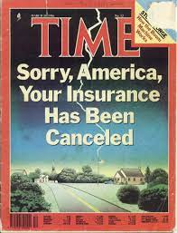
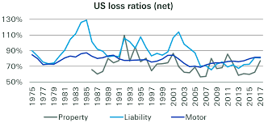
Municipal Insurance Funds in New Jersey

Slide 24

Municipal Insurance Funds in New Jersey
Before the 1980’s, local governments in NJ could not legally form insurance pools.
The nationwide insurance crisis in the 1980’s accelerated the need for an alternative to commercial insurance for local governments.
The NJSLOM and the NJSBA lobbied heavily for the enabling legislation.
The enabling legislation was passed, and the first local insurance pool was formed in Bergen County.
When excess coverage became unavailable, the need arose for the creation of a “super JIF,” the NJ Municipal Excess Liability (NJ MEL) Joint Insurance Fund to offer that coverage. The county equivalent, the NJ CEL, was created in 2010.

Slide 25

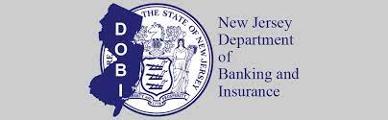
Municipal Insurance Funds in New Jersey
JIFs are governmental entities, NOT insurance companies. Specifically, JIFs are considered inter-local governmental entities, responsible for the insurance program of its members. NJ courts have upheld the JIF status as governmental entities.
Heavily regulated by the State of New Jersey, and must follow the rules for governmental entities.
There is joint oversight of JIFs by the NJ DCA and the NJ DOBI
The enabling legislation can be found at 40A: 10-36

Slide 26
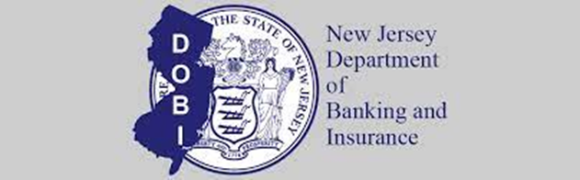


Municipal Joint Insurance Funds – State Regulation
NJ Department of Banking and Insurance
  Annual filing of budget, audit, contracts, and insurance policies. Every 4 to 5 years DOBI assigns an audit team to review the JIFs records and an actuary to verify the fund reserves
NJ Department of Community Affairs
  Annual filings as well. Reviews compliance with Fiscal Affairs, LPCL, Ethics Act, OPMA and OPRA.
NJ Office of the State Comptroller
  Required filing of contracts > $2 million approval for contracts >$10 million

Slide 27


Municipal Joint Insurance Funds – State Regulation
NJ Dept. of Labor and Work Force Development & NJ Dept. of Health
  Compliance with Public Employee Occupational Safety & Health regulations (PEOSH)
  NJ Right to Know requirements (DOH)
NJ Department of Environmental Protection
  Provides technical assistance and training for members

Slide 28
Operation of Municipal Joint Insurance Funds
JIF Commissioners are appointed by their respective local government entities, and must be either local elected officials or employees of member local units to serve. Elected officials serve for two years and appointed officials serve one year terms. There are no term limits.
Each JIF has formulated and adopted a set of Bylaws by which they will operate.
An Executive Committee and officers are elected at the reorganization meeting each January by the Commissioners.
JIFs are subject to the regulations contained in the Local Budget Law, Local Fiscal Affairs Law, Local Public Contracts Law, OPRA, and the Open Public Meetings Act.
The Executive Committee meets monthly to conduct business, according to the Open Public Meetings Act.

Slide 29
Risk Managers & the Defense Panel
Most JIFs require their members to retain a licensed insurance advisor to act as Risk Manager.
    Risk Managers fulfill a vital role for the member entities with expertise on insurance coverage and the specific exposures that are present in public settings.
    Risk Managers must be appointed pursuant to the NJ LPCL and subject to the same “Pay to Play” regulations applicable to all other professional appointments.
    Some JIFs require the same risk managers to be appointed for all members. Check the JIF By Laws to determine how the Risk Managers are appointed and compensated.
Each JIF appoints a panel of attorneys annually to defend cases on behalf of the JIF. The appointments are made pursuant to the NJ LPCL and subject to the same “Pay to Play” regulations applicable to all other professional appointments.

Slide 30
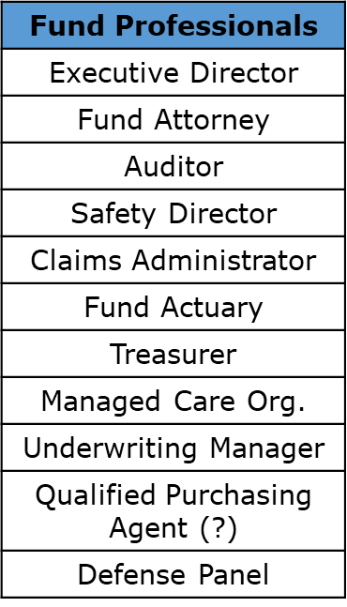
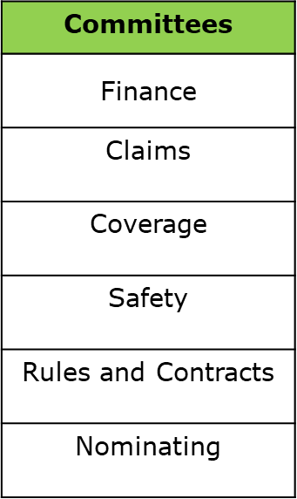

Organization of a Joint Insurance Fund
Fund Commissioners Appointed by Members
Executive Committee (Elected by Membership, MAX of 7)

Slide 31
Operation of Municipal Joint Insurance Funds
JIFS may be created and organized by:
  Geography – i.e., municipalities within a county or within a “region” or even more than one county
  Purpose – i.e., water and sewer authorities, housing authorities, first responders
  Form of Government – i.e., professional municipal manager form of government
  None of the Above

Slide 32
19 MEL Affiliated JIFS
Atlantic County Municipal JIF
Bergen County Municipal JIF
Burlington County Municipal JIF
Camden JIF
Central Jersey JIF
First Responder JIF
Gloucester, Salem, Cumberland Municipal JIF
Mid Jersey Municipal JIF
Monmouth County Municipal JIF
Morris County Municipal JIF
New Jersey Public Housing Authority
New Jersey Self Insurers JIF
New Jersey Utility Authorities JIF
Ocean County Municipal JIF
Professional Municipal Management JIF
Public Alliance Insurance Coverage Fund
South Bergen Municipal JIF
Suburban Metro JIF
Suburban Municipal JIF

Slide 33

NJ CEL Affiliated Members
Camden County Insurance Commission
Gloucester County Insurance Commission
Burlington County Insurance Commission
Cumberland Count Insurance Commission
Union County Insurance Commission
Mercer County Insurance Commission
Atlantic County Insurance Commission
Ocean County Insurance Commission
Monmouth County
Hudson County

Slide 34
Operation of a Municipal Joint Insurance Fund
The Responsibilities of the Fund Commissioners:
    To operate the Fund “in the interests of the total membership.”
    Formulate the annual budget, insurance coverage limits, authorize the purchase of reinsurance and determine all other operating and financial policies of the JIF
    Invest funds
    Enter into contracts in accordance with the NJ LPCL
    Adopt the Plan of Risk Management
    Join a Joint Insurance Fund (i.e., the MEL, or E-JIF).
    Establish and maintain a website with the following (at a minimum):
      Budgets (current year, and at least 2 prior years)
      Audit Reports
      Meeting Schedule
      Plan of Risk Management
      Bylaws
      Contact information
      OPRA policy and procedures

Slide 35
Operation of a Municipal Joint Insurance Fund
Plan of Risk Management
    Must be filed with the State of NJ DOBI and NJDCA
    The Plan is prepared by the JIF’s Underwriting Manager, adopted at the annual Reorganizational Meeting and must include:
      Lines of Insurance Coverage, limits and amount of “risk” retained by the JIF
      Reinsurance and Excess Insurance
      Methods to calculate member assessments
      Loss adjustment procedures
      Actuarial Methodology

Slide 36
Operation of a Municipal Joint Insurance Fund
By Laws
Indemnity and Trust Agreement
    Under the law in NJ, each member of the JIF must agree to be jointly and severally liable for JIF’s obligations. (The JIF is backed by the “full faith and credit” of the individual members.)
Membership Commitment
    Maximum commitment under the law is three (3) years
    Requires a Resolution of the governing body and a 2/3 approval by the JIF Executive Committee. Membership is not automatic, the approval is discretionary by the Executive Board.
    Notice to withdraw from the Fund requires 90 day notice, even if the commitment is expiring.
    Former members are still subject to “Special or Supplemental Assessments.”

Slide 37
Operation of a Municipal Joint Insurance Fund
Annual Reorganizational Meeting
    Usually held in January
    Elect Executive Committee (7 members or less) with alternates
    Elect officers (Chairperson and Secretary, and maybe a Vice Chair)
Meetings and compliance with OPMA
    Notice required
    JIF is required to establish and maintain a website
Assessments and Supplemental Assessments & Return of Surplus
    As determined by the budget
Conflicts of Interest
    Compliance with NJ LG Ethics Act

Slide 38
Operation of a Municipal Joint Insurance Fund
Claims
    Commissioners must approve claim settlements
    The appointed Claims Administrator prepares the PAR’s each month for review.
    Claims committee reviews and recommends approval (or denial) of Payment Authority Requests (PAR’s) each month.
Dissolution of the Fund
    All outstanding claims must be paid before a JIF can apply to the DOBI for approval to dissolve. Some claims take decades to resolve. Dissolution requires a vote of the entire membership.

Slide 39

Employee Safety

Slide 40
Why Does Safety & Risk Control Matter?
The Keys To Effective Risk Control
Training
Education
Actual $ Saved
Mgmt. Commitment

Slide 41

Employee Safety Programs
What we know…..
  The first national workplace safety regulations were not put into place until 1970, when President Nixon signed the Occupational Safety and Health Act (OSHA). NJ PEOSH covers public employee workers.
  Municipal and county entities with viable & effective Safety Committees experience fewer accidents with less costs incurred.
  Police (34%) and Public Works (46%) accidents account for 80% of all accidents. Add in EMS and Firefighters, and it is 90%.
  43% of all Fire Department fatalities are the result of heart attacks
  A police officer, firefighter or DPW worker has a HIGHER chance of being injured on the job than an underground miner or construction worker.
  Effective safety and risk control programs WORK.

Slide 42
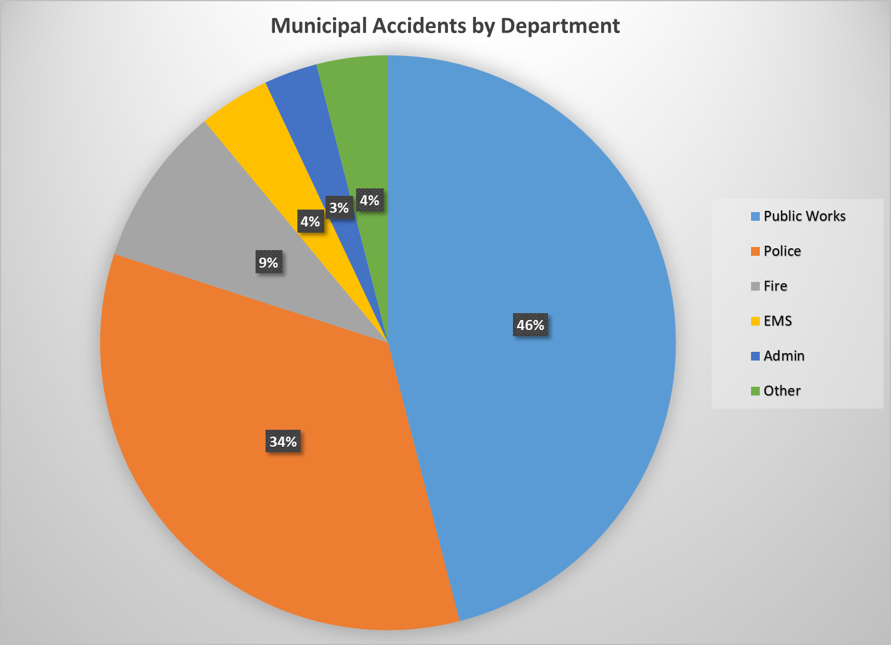
Targeted Approach

Slide 43
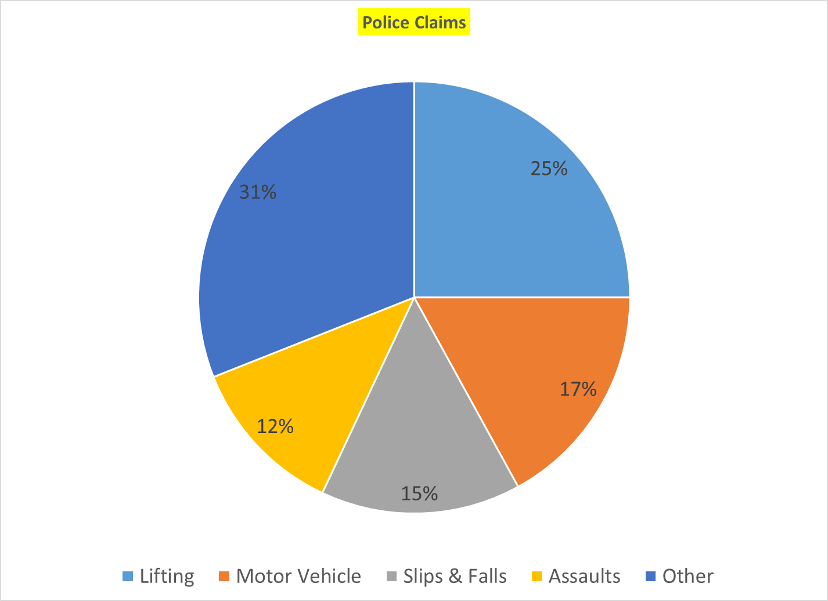

Slide 44
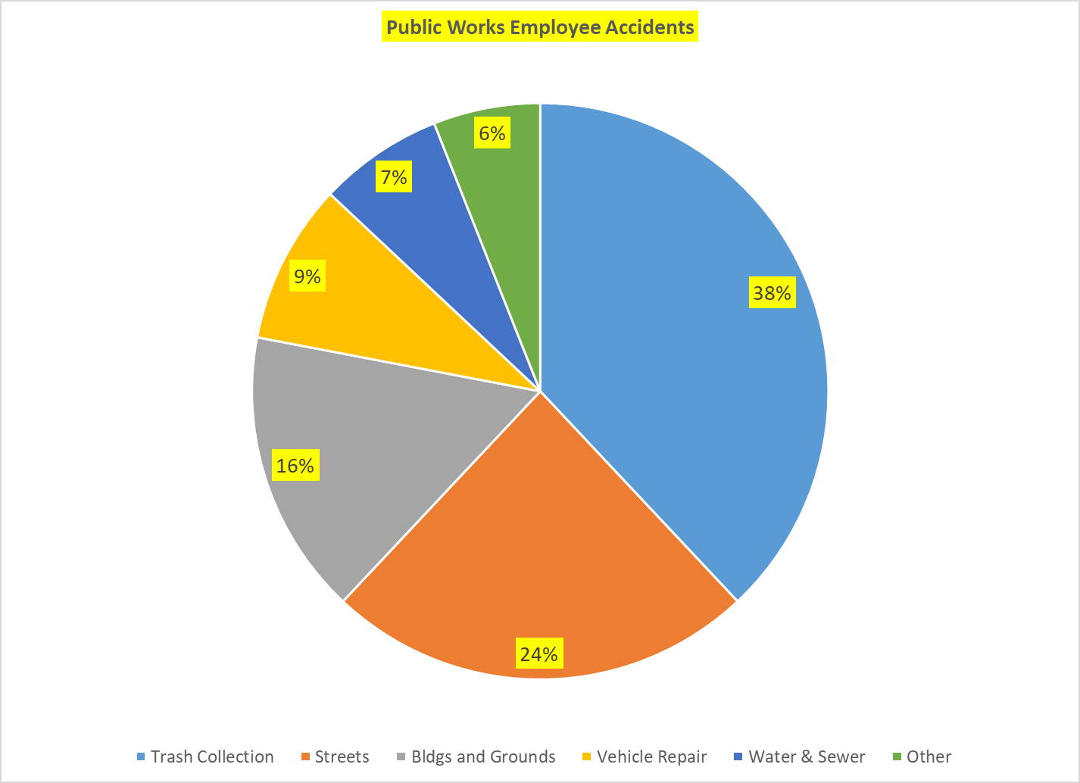

Slide 45
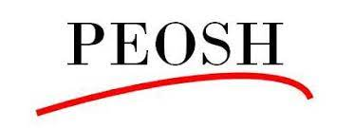
Effective Management Strategies That Impact Safety in a Positive Way
Monitor Safety Performance.
Empower employee involvement in the safety program.
Require ALL personnel to complete safety orientation and periodic refresher training.
Discuss safety with employees at the start of each shift.
Actively participate in accident investigations.
Monitor PEOSHA compliance.

Slide 46
Creation of a Safety Committee
Plans and implements the safety and risk control program.
Should include the risk management consultant, representatives from management, collective bargaining units, and non-union employees. All departments should be represented and there should be a representative from senior management who attends but does not run the meeting.
An agenda should be prepared that includes a review and discussion of all insurance claims by the membership. Meeting minutes should be taken and approved. Other agenda items should include any safety concerns from the employees.
A review of all training programs should be conducted along with preparation of a training plan for each department and each employee.

Slide 47
Measuring the Effectiveness of
Loss Control Programs
Lost Time Accident Frequency or LTAF
  The Lost Time Accident Frequency is a standard OSHA metric that calculates the number of incidents that result in time away from work. Not all recordable incidents result in lost time, which is why there is a separate calculation for these more severe incidents.
  The “safer” the work environment is, the lower the LTAF.
  Statistics show that ongoing training and education of workers is the most effective tool in reducing the LTAF and keeping it low.

Slide 48
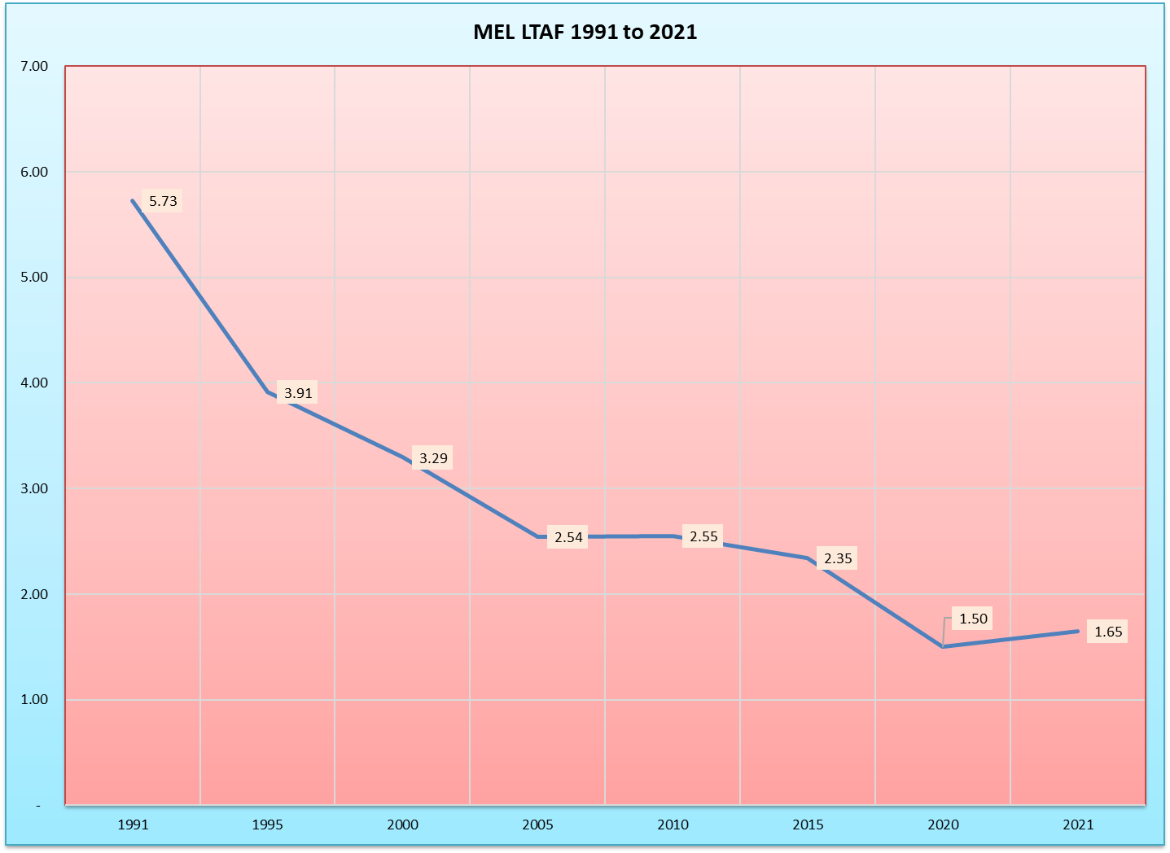
Lost Time Accident Frequency (LTAF)

Slide 49
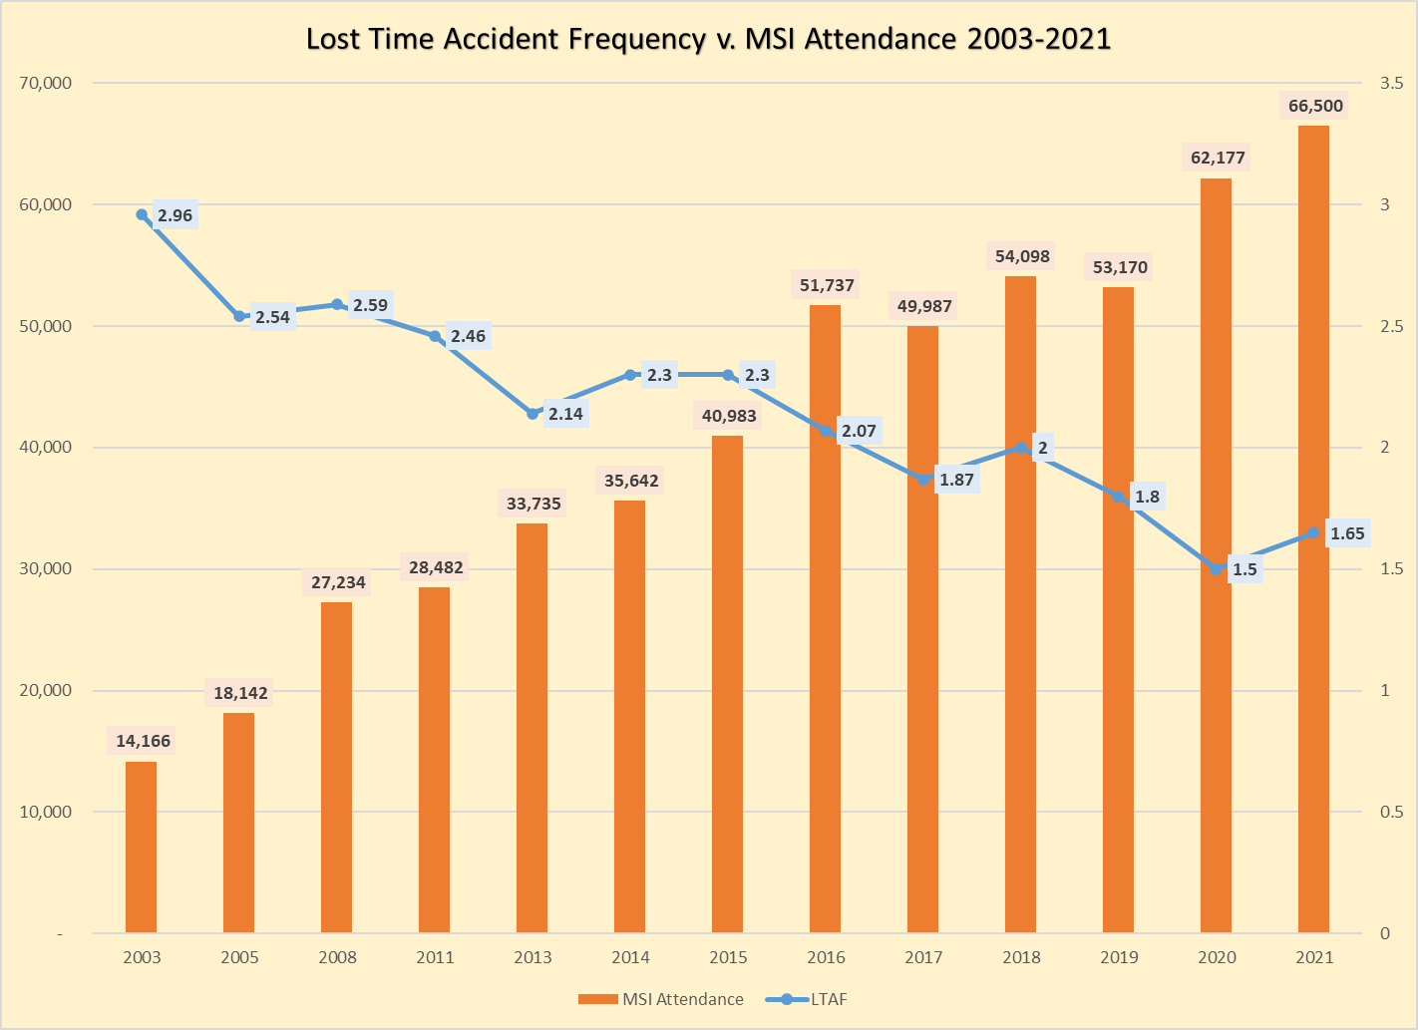
LTAF and MSI Usage

Slide 50
Training Resources Available
MEL Municipal Safety Institute (MSI) (NOTE: The NJCEL members also have access to the same resources.)
  MELSAFETYINSTITUE.ORG
    MSI LIVE – Virtual Instructor-Led Training and In-Person Training (See Catalog with over 60 course titles)
    MSI NOW – Digital Streaming Safety Library with over 200 titles
    MSI DVD – Safety Video Lending Library with over 400 titles
    MSI Briefings – Short Video Briefing Programs on Safety Subjects
    MEL Online Videos – Professionally produced videos on MEL website
    MSI Leadership Academy – New initiative to train supervisors

Slide 51
Training Resources Available
MSI Forms and Documents
MSI Model Policies
MSI Law Enforcement Training Resources
MSI Safety Bulletins
One on One Consultation with:
  Safety Professionals, including loss control visits and job safety observations on an ongoing basis
  Former Police Command Staff Officers – including one on one meetings with Chiefs of Police and Law Enforcement Ad Hoc Committee Meetings

Slide 52

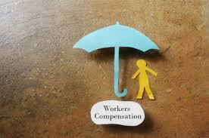
Workers’ Compensation

Slide 53
Workers’ Compensation in NJ
Law is found at: N.J.S.A. 34:15-1 et. seq.
Half the cost of local government property/casualty claims is attributed to Workers’ Compensation.
Until the start of the 20th century, employees injured on the job were forced to sue their employers for negligence under common law.
NJ was the first state to adopt a permanent workers’ compensation law where benefits are provided for traumatic injuries and occupational disease.
WC coverage is “no-fault.”
  The injured worker must only be able to show that the injury occurred during the course of work and arose out of work. They do not need to prove the employer was negligent.

Slide 54
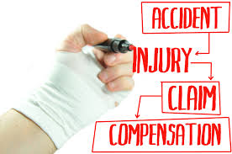
Workers’ Compensation in NJ
WHO IS COVERED?????
  Regular and not “casual” employees.
  Independent contractors may be covered if the employer exercises effective control over the independent contractor as if the contractor was an employee or if the employer has a “long-term economic dependency” on the independent contractor. Based on this legal interpretation, what do you want to make sure of?
  Are volunteers covered?

Slide 55
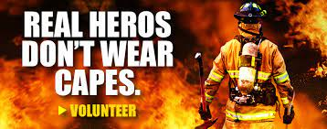
Workers’ Compensation in NJ
Certain volunteers are covered:
  Elected and appointed officials
  Board of Education members
  Volunteer Firefighters
  Volunteer First Aid Squad workers
  Reserve or auxiliary police officers

Slide 56
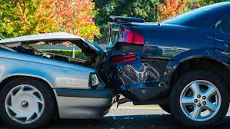
Workers’ Compensation in NJ
When is the employee covered?
  Generally (but not always), coverage starts when an employee arrives at the employer’s premises and ends when the employee leaves.
    First Responders are covered when traveling from home to the scene or when traveling to the station to pick up equipment needed to respond to an emergency.
    Employees traveling for work to another location as part of their job are covered.

Slide 57
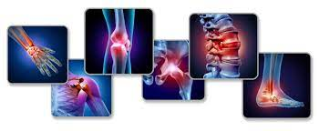
Workers’ Compensation in NJ
Occupational Disease Claims, i.e., “injuries or illnesses caused by repetitive activity or exposures over a period of time.”
  Include musculoskeletal issues, hearing loss, PTSD, and Lyme disease.
Heart Attacks
  1995 NJ Supreme Court decision
  To be compensable, heart disease must also be:
    Due in a material degree to causes which are characteristic to a particular occupation
    The work exposure exceeds the exposure caused by the workers’ personal risk factors such as smoking, and
    The employment substantially contributed to the development of the disease

Slide 58

Workers’ Compensation in NJ
Heart Attacks (continued):
  A heart attack suffered by an on-duty police officer or firefighter is presumed to be compensable under a special provision of the law in NJ.
  Extended to cover emphysema contracted by firefighters in 2003.
  New legislation in 2019 established that cancer is also presumed to be job-related if a firefighter has at least seven (7) years experience on the job. The presumption covers both volunteer and career firefighters and expires when the firefighter reaches age 75.
  Can be rebutted by the employer if the “preponderance of the evidence” shows that the cancer or heart attack is unrelated to firefighting.
  Public Safety Workers are also eligible for the same presumption when exposed to communicable diseases.

Slide 59

Workers’ Compensation in NJ
Special Coverage Issues:
    Recreational or Sports Events
    Horseplay
    Intoxication

Slide 60

Question for You
Are COVID-19 Claims Covered by Workers’ Compensation?

Slide 61
COVID-19 Workers’ Compensation Claims
Senate Bill 2380 Signed into law on 9/14/2020 by Governor Murphy
Creates a “rebuttable presumption” of WC coverage for COVID-19 cases contracted by “essential employees” during a public health emergency declared by an Executive Order by the Governor. Effective retroactively to 3/9/2020.
Public safety workers or first responder including police, fire, or EMTs.
Medical or healthcare provider
Essential to the public’s health, safety, and welfare
“Loosely” interpreted

Slide 62

Impact on Public Employees in the MEL System
Since 3/9/2020:
  12,901 claims filed
  Total paid out $14.16 million (And Counting….)

Slide 63
Workers’ Compensation in NJ
Benefits Under WC:
  Necessary Medical Care – Directed and managed by the employer
  Temporary Disability Payments if off from work.
    70% of the employee’s earnings up to the state-average weekly wage, which is established annually by the Workers’ Compensation Bureau.
    There is a seven-day waiting period before becoming eligible; but once this is satisfied the payment is retroactive.
    Not subject to federal or state wage tax or social security tax.

Slide 64
Workers’ Compensation in NJ
Temporary Disability Payments if off from work (continued):
  Payments stop when the doctor certifies that the employee has reached “maximum medical improvement,” even if the employee cannot return to work yet. At that point, the employee is evaluated for an indemnity award. (to be discussed later)
  If there is any doubt about the employee’s ability to perform a particular job, the employer may schedule a “functional capacity exam” (FCE).
  In lieu of temporary disability payments, many local government employees receive their full salaries for up to one year when they are off from work because of a job-related illness, injury or disability. The JIF will reimburse the employer based on the State average.

Slide 65

Workers’ Compensation in NJ
Indemnity Awards:
  Employees also receive compensation for permanent disabilities, computed as a percentage of a body part, or in some cases, a percentage of the whole body. The rating for an indemnity award has no bearing on the actual ability of an employee to return to work.

Slide 66

Workers’ Compensation in NJ
Special Claims Issues
  Coordination of WC with State Pensions
  Coordination of WC with Social Security Disability
  WC Courts – set up under the NJ Dept. of Labor, no juries
  Reopening Claims – up to 2 years after the last WC payment
  Section 20 Settlements
  Second Injury Fund
  Subrogation

Slide 67

Workers’ Compensation in NJ
Managing the Claims Process
  Use the most skilled physician
  Maintain contact with the injured employee
  Return the employee to work as soon as possible – “Transitional Duty”
  Include your attorney in the claims control discussion
  New tools – establishing a baseline for each employee.

Slide 68

Workers’ Compensation Fraud
Investigations should be conducted if fraud is suspected
Fraud may be subject to criminal prosecution
Suspicion is NOT sufficient grounds for dismissal
However, the filing of a WC claim does not immunize the employee from adverse employment action for other legitimate reasons.

Slide 69
Break Time
We will now take a 10-minute break. Please be back in ten minutes. Thank you!

Slide 70
Transitional Duty Policy for WC

Slide 71

Selected Case Law
Kossack V. Bloomfield (1960)
  Police officer was injured at home while cleaning his service revolver. There was no provision in the department’s policies that specified where or when officers were to maintain their revolvers.
  Court ruled the officer was covered by WC because he had a duty to keep the service revolver clean and serviceable, and was “unquestionably fulfilling the duties of office.”

Slide 72
Selected Case Law
Peterson v. Alpine (2001):
  Off-duty police officer was injured while directing traffic at a Bell Atlantic worksite. He filed for workers’ compensation from the town, which argued that Bell Atlantic should pay the claim.
  The court ordered both the town and Bell Atlantic to split the WC because the officer was hired by the utility company through the town.

Slide 73
Selected Case Law
Wasik v. Bergenfield (2003):
  The petitioner engaged in horseplay with another sanitation worker, who became offended and struck the petitioner.
  Court found that the petitioner’s actions were neither extensive nor serious and that the other employee overreacted. Therefore, the petitioner was entitled to WC even though he was the instigator of the sequence of events that resulted in the altercation.

Slide 74
Selected Case Law
Lindquist v. Jersey City (2003)
  A career firefighter who was a heavy smoker applied for WC when diagnosed with emphysema.
  Court ruled he was entitled to compensation even though he was not able to clearly establish causation. The court wrote, “We reemphasize that it is not necessary for the firefighter to prove that the firefighting was the most significant cause of his disease. Rather, he need only show that his employment exposure contributed in a material degree to the development of his emphysema.”

Slide 75
Selected Case Law
Minter v. Mattson (2018)
  The town told an employee that it was “critical to come to work” during a heavy snowstorm. The employee was injured in a vehicle accident during the commute.
  While workers’ compensation coverage does not usually begin until the employee reaches the workplace, the “going and coming” limitation does not apply if the employee is required to travel in dangerous conditions.

Slide 76
Selected Case Law
Martin v. Newark Public Schools (2019):
  The employee injured his back in an employment-related auto accident and was prescribed an opioid to relieve pain. After six years, the employer refused to continue paying for the opioid, arguing that the prescription was palliative and was not helping improve the patient’s functioning.
  Court ruled that an employer does not need to pay for pain relievers indefinitely and there may be a point that the pain or disability experienced by the worker is insufficient to warrant the expense of active treatment.

Slide 77
Selected Case Law
Hager v. M&K Construction (2020)
  A construction worker suffered a serious back injury in 2001 and went through years of treatment. In 2016, a pain specialist recommended medical marijuana. The insurer alleged that this was not appropriate treatment because marijuana is an illegal substance under federal law.
  Court ruled that the employer is required to pay for medical marijuana when prescribed in a WC case. Since the employer is not required to process, manufacture, or distribute marijuana, there is no conflict between the Federal Controlled Substances Act and NJ Medical Marijuana Law.

Slide 78

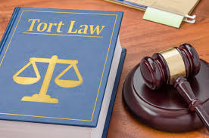
Tort Claims and Title 59 Immunities

Slide 79
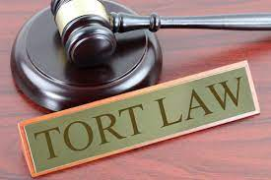
What in the world is a “Tort Claim?”
A tort is an act or omission that gives rise to injury or harm to another and amounts to a civil wrong for which courts impose liability.
The law recognizes torts as civil wrongs and allows injured parties to recover for their losses. Injured parties may bring suit to recover damages in the form of monetary compensation or for an injunction, which compels a party to cease an activity. In certain cases, courts will award punitive damages in addition to compensatory damages to deter further misconduct.
The Federal Tort Claims Act is a 1946 federal statute that permits private parties to sue the United States in a federal court for most torts committed by persons acting on behalf of the United States. Historically, citizens have not been able to sue their state—a doctrine referred to as sovereign immunity.

Slide 80
Title 59 in New Jersey
Conceivably almost any accident that happens could result in a lawsuit against a local governmental entity.
While private entities have the ability to limit the scope of their activities, for the most part, government does not.
Local governments in NJ were protected by “sovereign immunity” until 1959 when the NJ Supreme Court ruled that governmental employees could be sued for failure to perform ministerial duties but not for discretionary activities.
The NJ Sup. Ct. struggled to determine what discretionary activities should have immunity over the next 11 years, ultimately inviting the NJ Legislature to adopt a Tort Claims Act.

Slide 81


Title 59 in New Jersey
Title 59 was passed by the State Legislature in 1972, and it provides governmental entities and employees with immunity to civil suit UNLESS a separate law establishes liability.
  Modeled after the State of California Tort Statute
  Incorporates the concept of “modified governmental immunity.”

Slide 82
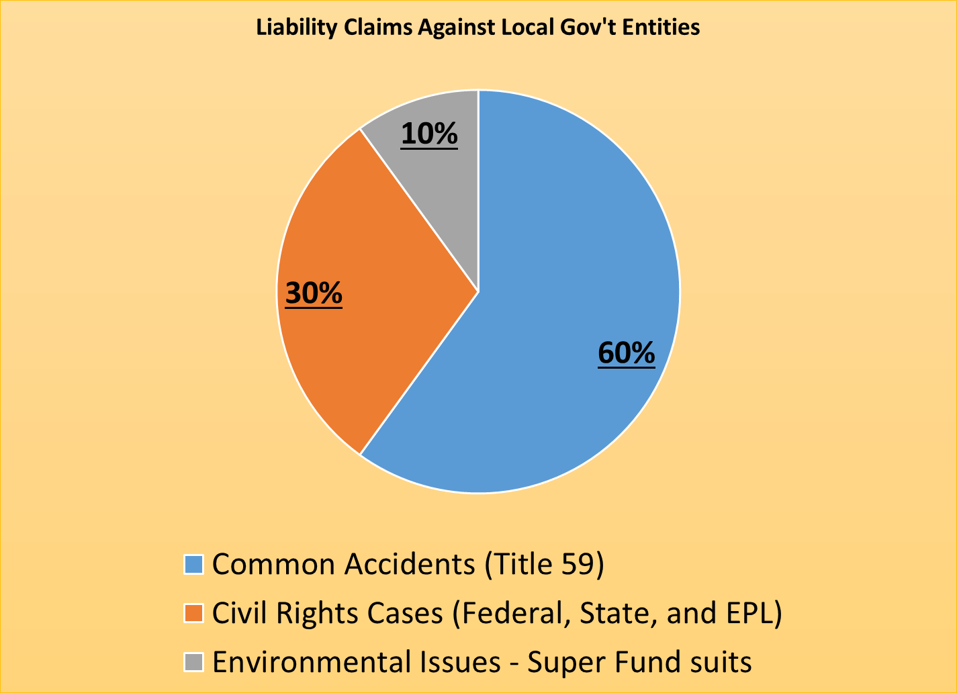
Liability Claims Against Local Government

Slide 83
Discretionary Immunity
Section 2 of Title 59
All NJ public entities (municipalities, counties, authorities and the State of NJ) are granted broad immunity for the exercise of governmental discretion.
Section 3 of Title 59, extends discretionary immunity for:
    Good faith enforcement or failure to enforce any law
    Issuance, denial, suspension, or revocation of permits or orders, or the failure to do so.
    Failure to inspect, or negligent inspection of property

Slide 84
Discretionary Immunity
“The law does not protect a public employee from liability if it is established that his conduct was outside of the scope of his employment or constituted a crime, actual fraud, actual malice, or willful misconduct.”
    A public entity may be immune but individual employees or officials may not be immune.

Slide 85
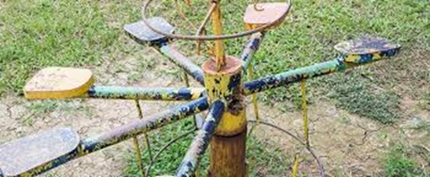
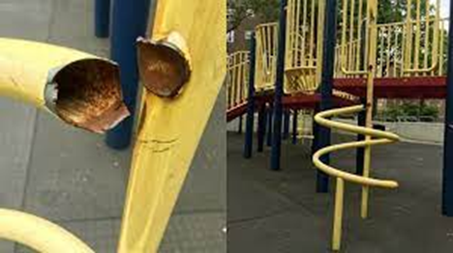

Recreational Immunity
Recreational Immunity
    Immunity for failure to provide supervision of recreational facilities
    No immunity for failure to protect against a dangerous condition

Slide 86

Police Qualified Immunity
Law Enforcement Immunity (Qualified Immunity)
    No requirement that a municipality maintain a police department
    Police officers are immune as long as the officer acted in “good faith” which means “honesty of purpose and integrity of conduct without knowledge, either actual or sufficient to demand in inquiry that the conduct is wrong.”
    Immunity does not apply to false arrest or false imprisonment
    Officers are required to intervene if a fellow officer is violating someone’s civil rights or using excessive force.

Slide 87
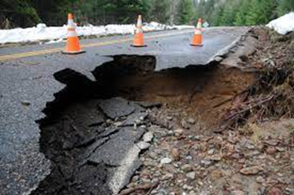
Accidents on Public Property
To prevail a plaintiff must establish:
    The claimant was using public property with reasonable care for it intended purpose
    The public property was in a dangerous condition
    The public entity had actual or constructive notice of the dangerous condition that caused the accident
    The action or inaction of the public entity or employee was “palpably unreasonable,” (i.e., actions or inactions that no prudent person would approve.)

Slide 88

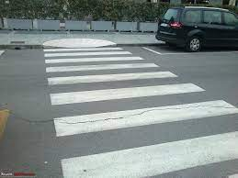
Protections from Civil Suits
Design Immunity
Scarce Resources
Sidewalks and Curbs
    Residential v. Commercial Property Owners
Snow and Ice Immunity
Streets and Crosswalks
Unimproved Property

Slide 89
Other Provisions
Fire Dept. and Ambulance Corps
States of Emergency
Verbal Threshold ($3,600)
Collateral Source Rule – Award reduced by insurance
Sewage Backups – No liability if in sewer lateral, may have liability in main
Statue of Limitations
    Claim within 90 days, lawsuit in 2 years
Punitive Damages
    Permitted for civil rights, sexual molestation, and environmental liability suits. Not usually covered by insurance

Slide 90
Litigation Risk Committee
Mayor (or County Director, Chairman of Authority), Manager or Executive Director, Local Unit’s Attorney, RMC, and Other Dept. Heads (plus Safety Comm. Chair)
Works collaboratively with the Safety Committee
Litigation
Ordinances
Policies
Planning

Slide 91

Litigation Risk Committee
Responsibilities:
  Litigation monitoring
  Review of Pertinent Ordinances and Resolutions
  Inspections of property and facilities
  Reporting and follow-up
  Capital Planning
  EPL Update
  ADA Review
  Land Use Review
  Child Abuse Policy Review
  Review coverage issues with RMC and Underwriter
  Special Events and Use of Public Facilities
  Environmental Liability
  Ethics and Open Public Meetings Act Review

Slide 92
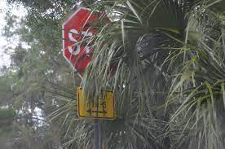
Cases
Shuttleworth v. Conti (1984)
    An intersection accident occurred when a motorist failed to stop because foliage covered the stop sign. The town argues that it was eligible for immunity because it lacked the resources to trim all of the foliage around town.
    The court ruled that the allocation of scarce resources immunity did NOT apply because leaving stop signs obscured was palpably unreasonable.

Slide 93

Cases
Kolitch v. Lindedahl (1985):
    Motorist lost control of his vehicle at a dangerous curve that lacked a warning sign. The plaintiff was able to show that the speed limit was entirely too high and that there had been numerous accidents at this curve. Therefore, the town was on notice, but failed to act.
    The NJ Supreme Court held that discretionary immunity applies to the placement of permanent traffic signals and signs, and the establishment of speed limits.

Slide 94
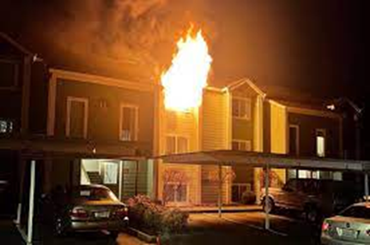
Cases
Thompson v. Newark Housing Authority (1987)
    A child died in a fire at a high rise apartment building that lacked smoke detectors. The Housing Authority argued that it was eligible for design immunity because the plans had been approved before smoke detectors became mandatory.
    The NJ Sup. Ct. ruled that design immunity did not apply because the question of smoke detectors had not even been considered at the time of construction, and therefore, there was no discretionary immunity to immunize.

Slide 95

Cases
Levin v. Salem County (1993):
    A young man dove off of a county-owned bridge into a river, struck his head on a sandbar and suffered a broken neck. For years the county had known that people often dove from this bridge but did not place any warnings and made no effort to stop the practice.
    The court ruled the county was not liable because the injured party must establish that the property was being used for its intended purpose. Bridges are not intended to be diving platforms.

Slide 96
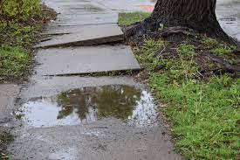
Cases
Petrocelli v. Sayreville Shade Tree Commission (1997):
  Plaintiff was injured when her bicycle struck an uneven sidewalk caused by the roots of a shade tree. She sued both the town and the Shade Tree Commission
  Court ruled that when the town establishes a “Shade Tree Commission” both the town and the commission become immune from lawsuits alleging failure to maintain trees.

Slide 97
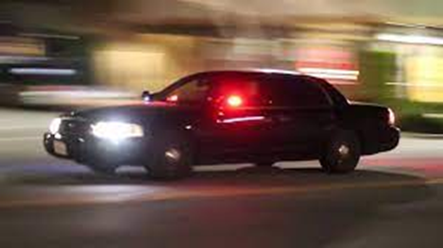
Cases
Jones v. Hartford (2003):
    At 4 a.m. plaintiff was a passenger in a car stopped by police because it met the description of a vehicle that had been reported hijacked at gunpoint. One of the responding officers roughed up and injured the plaintiff, even though the plaintiff did not resist. Fellow officers did not intervene. The report ultimately proved to be a hoax.
    Court ruled that the fellow officers were not eligible for immunity and were liable because they have an affirmative duty to protect a citizen’s civil rights.

Slide 98
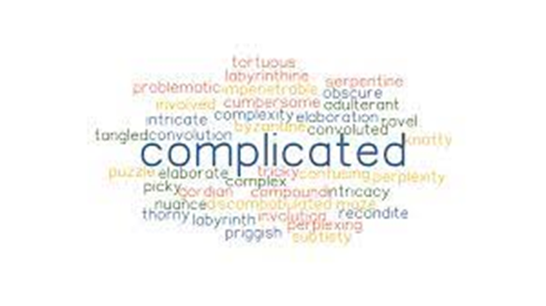
Lessons Learned
Title 59 is complicated. Actively solicit the advice of your local attorney, and the other professionals retained by your JIF.
Creation of a Litigation Risk Committee is an excellent way to coordinate and manage the conditions that give rise to claims and lawsuits.
The most important tool is DOCUMENTATION of your efforts to address dangerous conditions and significant discretionary decisions.

Slide 99



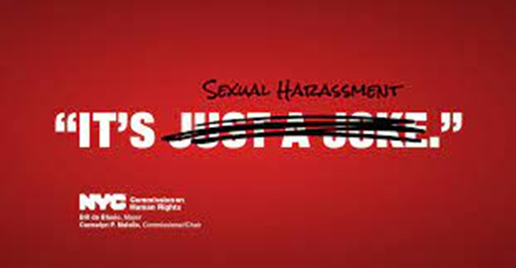
Employment Practices Liability
Also known as “When otherwise very smart people sometimes do inexplicably stupid things in the workplace that cost money.”

Slide 100
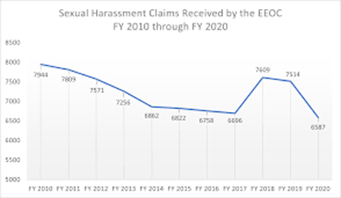
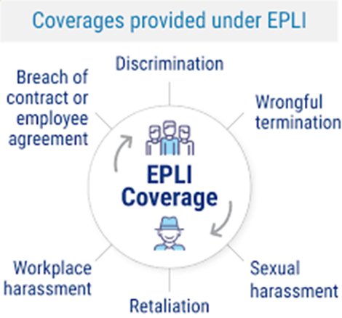
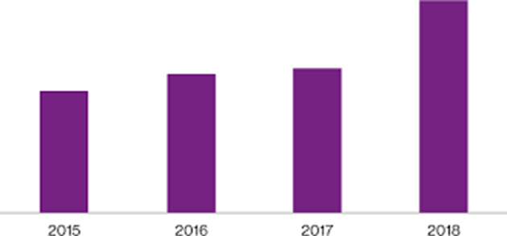
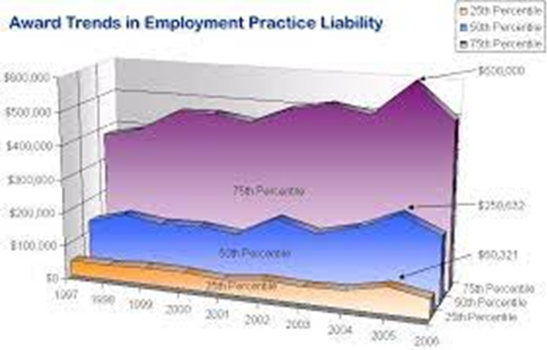
Employment Practices Liability (EPL)

Slide 101
NJ Law Against Discrimination (NJLAD)
NEW JERSEY LAW AGAINST DISCRIMINATION (LAD): The LAD prohibits unlawful employment discrimination based on the following “protected classes”:
    an individual's race, creed, color, national origin, nationality, ancestry, age, sex (including pregnancy), familial status, marital/civil union status, religion, domestic partnership status, affectional or sexual orientation, gender identity and expression, atypical hereditary cellular or blood trait, genetic information, liability for military service, and mental or physical disability (including perceived disability, and AIDS and HIV status)
    First anti-discrimination law in the US (1945)

Slide 102

NJ LAD
The act allows “fee-shifting” where the defendant must pay the plaintiff’s legal bills if there is ANY award.
As a result of “fee-shifting,” legal costs now represent approximately 70% of the total cost of employment-practice actions.
    One example:
      Plaintiff rejected a settlement offer of $75,000 and was awarded only $20,000 from the jury. Plaintiffs counsel submitted a fee application for $671,000, and eventually received $450,000 for attorney fees.

Slide 103
NJ LAD
Early on, most claims and lawsuits against local government involved equal employment opportunities for women and minorities.
Today, however, there are far more lawsuits arising from promotional disputes. Two-thirds of these cases come from police departments.
Elected officials need to “insulate” themselves from charges of either favoritism or retaliation. Recommended actions:
    Adopt a Police Promotional Ordinance
    Contract with an outside agency to interview qualified applicants and provide an objective analysis
    If the town is NOT a Civil Service town, an outside agency should also conduct a written test.

Slide 104

On the Job Harassment
Some alarming statistics:
    81% of women and 43% of men have experienced some form of sexual harassment during their lifetime. This includes verbal, physical, and cyber harassment and sexual assault.
    68% of women reported being sexually harassed in a public space, 38% at work and 31% at their home.
    Harassment is largely fueled by “power imbalances,” marginalized communities including women of color, immigrants, domestic workers, and those in the LGBTQ community are uniquely vulnerable.

Slide 105
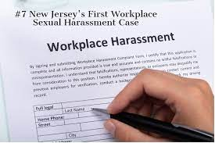
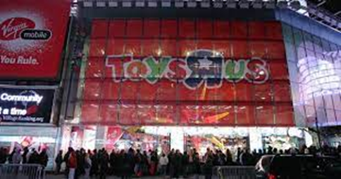
Lehmann v. Toys R Us (1993)

Slide 106
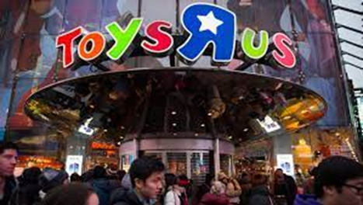
Lehmann Case
Landmark decision in our State for harassment on the job, NJ Supreme Court Case (1993)
Theresa Lehmann was a supervisor in the Purchasing Dept. at Toys R Us, and she was subject to numerous touching incidents, unwanted sexual advances and inappropriate comments by her superior.
She complained to her superiors, but was told to “work it out.”
She complained to senior management, but there was no change.
She was offered a transfer but rejected it.
She ultimately resigned and filed suit.

Slide 107
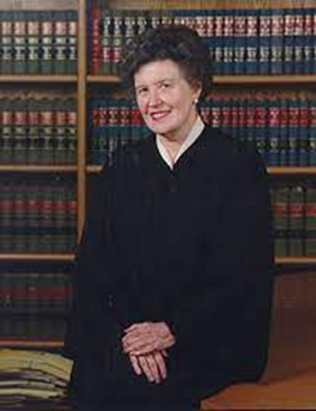
Lehmann Case
The Court ruled that an employer is responsible for sexual harassment committed by its supervisory employees unless the employer established an EFFECTIVE anti-harassment program.
The court made it clear the decision is not limited to sexual harassment, but applies to all harassment in the workplace based on an employee belonging to a “protected class.”
Judge Garibaldi wrote the decision.

Slide 108
Components of an Effective
Anti-Harassment Program
Written policies and procedures that prohibit discrimination and harassment in the workplace. The MEL responded by developing a “Model Employment Policies and Procedures Manual” that is updated every two years, and available on the MEL Website.
Both formal and informal complaint procedures (Included in the Model Manual.)
Mandatory management training no less frequently that bi-annually, and training for all other employees no less frequently than every three years.
An effective system to monitor compliance, to ensure that the complaint structure is “trusted” by employees.
An unequivocal commitment from senior management that demonstrates consistent practice through action over words.

Slide 109
Lehmann Decision
Harassment in the workplace is actionable if it creates what a reasonable person would consider a situation “sufficiently severe or pervasive to create an intimidating, hostile or offensive working environment.”
NJ Supreme Court reaffirmed the principles in the Lehmann decision in a 2002 case, Mancini v. Teaneck.
    Mancini was a female police officer in Teaneck who was subjected to 15 years of “low level harassment.”
    The court found in her favor, and she received $125,000 in compensatory damages and $500,000 in punitive damages, plus interest.
    Fee Shifting = Her attorney received $700,000 in fees
    The town paid its attorney $1 million to defend the case. Total cost to the town = $3 million.

Slide 110
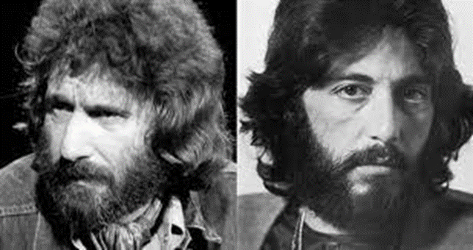
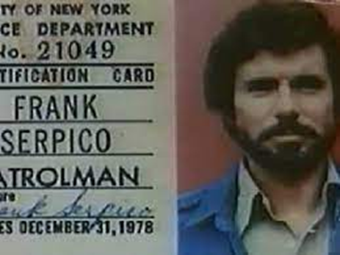
NJ Conscientious Employee Protection Act
Passed in 1985 during the Kean administration, also known as CEPA
Designed to prevent “Serpico” situations.
Protects governmental employees from being fired or demoted in retaliation for focusing the spotlight on official activity that harms or potentially harms the general public.
Also known as the “Whistleblower Act.”

Slide 111
NJ CEPA
“An employer shall not take any retaliatory action against an employee because the employee discloses an activity, policy, or practice that the employee reasonably believes:
    Is in violation of the law
    Is fraudulent or criminal
Fee shifting applies to CEPA cases
Statute of limitations is one-year, as opposed to NJLAD with a two-year statute of limitations.
Requires ANNUAL posting of a notice to employees.
Used by employees now to gain leverage to fight almost any otherwise legitimate job action.

Slide 112
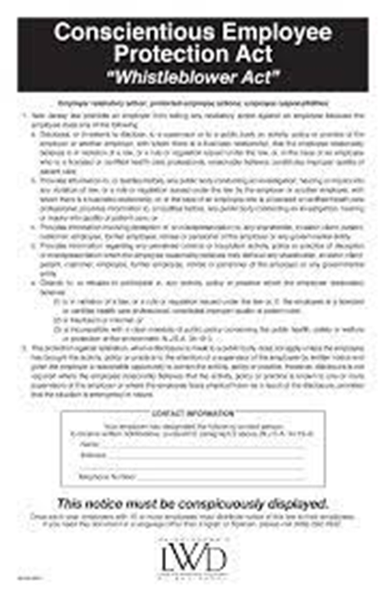
NJ CEPA

Slide 113

Court Cases – Harassment
Moorestown v. Armstrong (1965):
    Police officer was fired for “conduct unbecoming” after a series of incidents, including an altercation with his wife, where he threatened to kill the Chief and take his own life. CSC found him guilty of the infractions but found that the penalty was too severe. Town appealed.
    Court held that police officers can be held to a “higher standard” because the carry weapons and have arrest powers.

Slide 114
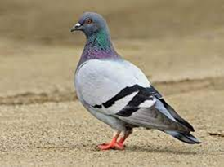
Court Cases – Harassment
Lakes v. Brigantine (2007):
    DPW worker complained when fellow employees started to shoot pigeons nesting in the garage. Management did not think the issue warranted serious consideration, and fellow employees started teasing the complaining worker as “Pigeon Man.” The worker complained about this harassment and ultimately sued under CEPA.
    Court ruled the town was liable because harassment from fellow employees could be considered a form of retaliation under CEPA if management fails to take steps to halt the harassment. Jury awarded $250,00 for compensatory damages and $400,000 for punitive damages, and fined the town $10,000.
    Judge REDUCED the compensatory damages to $100,000.

Slide 115
Court Cases – Harassment
Cutler v. Dorn (2008)
    A Jewish police officer sued under NJ LAD based on a series of minor comments and jokes over the years. In some cases, the officer participated in the “give and take.” The judge threw out the case, and the officer appealed. The Appellate Division agreed with the lower court judge and ruled the comments in question were only “breaking chops and teasing.”
    NJ Supreme Court disagreed, and said the Appellate Courts statement “undervalues these stereotypic references and demeaning comments” and these “isolated incidents could be viewed, in the aggregate, to create an objectively humiliating and painful environment. “

Slide 116
Court Cases – Harassment
Groslinger v. Wyckoff (2009):
    Police officer alleged gender discrimination and sexual harassment after her supervisor and several employees made caustic remarks when she could not continue to work during a difficult pregnancy. The Town Administrator investigated the complaints and found the supervisor’s remarks to be inappropriate but found no discriminatory intent. He disciplined the supervisor and ordered additional anti-harassment training.
    The court granted summary judgment dismissing the case because the town consistently followed and implemented its anti-harassment program.

Slide 117

Court Cases - Harassment
Buonanno v. Elmwood Park (2014):
    A Construction Official was laid-off when the town voted to hire a neighboring town to perform this function. The official alleged that one of the council members, who was an active builder in the neighboring town, violated the common law and Local Government Ethics Act by voting on the consolidation.
    The court ruled that the Construction Official must be rehired with back pay. The vote to eliminate the position was invalid because a council member inadvertently violated the Ethics Act by voting to retain the neighboring town’s construction office where he was an active builder.

Slide 118

Court Cases - Harassment
Smith v. Millville (2016):
    The Director of Operations at a rescue squad reported that he was having an affair with a volunteer and commencing a divorce against his wife, another employee of the squad. After he was fired, he sued based on the NJ LAD provision that prohibits discrimination because of marital status.
    The NJ Supreme Court ruled that the squad was potentially liable because LAD’s protection based on marital status is not limited to being single or married and extends to people who are separated or divorced.

Slide 119

Court Cases - Harassment
Sauder v. Colts Neck (2017):
    A 20-year member of a Volunteer Fire Department reported to an insurance company that the Department had made certain false statements in a claim involving embezzlement of the Department’s funds by another member. The Department brought the volunteer up on charges and terminated him in a 14 to 8 vote. The volunteer sued, contending the Dept.'s actions violated CEPA. When the Dept. argued that CEPA only covers employees, the volunteer pointed out that under the law, volunteer firefighters are covered by Workers’ Compensation and also receive a Length of Service Award Program (LOSAP) and uniform allowance.
    Court ruled that for purposes of CEPA, volunteer firefighters are not employees.

Slide 120


The Americans With Disabilities Act (ADA)

Slide 121

The Americans With Disabilities Act (ADA)
Signed into law by President George H.W. Bush in 1990
Often credited as the world’s first civil rights law for people with disabilities
“..to assure equality of opportunity, full participation, independent living, and economic self-sufficiency for individuals with disabilities….”
ADA bans discrimination on the basis of disability in the areas of:
    Employment
    Public Accommodation
    Public Services
    Transportation
    Telecommunications

Slide 122

The Americans With Disabilities Act (ADA)
Title I of the act addresses employment
Title II addresses public services, programs, and activities provided by State and local governments
Title III addresses public accommodations such as restaurants, theaters, offices and places of business

Slide 123

ADA – Title I – Employment
Prohibits discrimination against qualified individuals with disabilities, defined as:
    Physical or mental impairment that limits one or more life activities
    Individuals with a record of an impairment
    Individuals regarded as having such an impairment
Requires employers to make “reasonable accommodation” to enable people with disabilities to enjoy equal employment opportunities if such would not pose an “undue hardship.”
    Making facilities accessible
    Job restructuring
    Acquiring or modifying equipment
    Sign language interpreters
    Flex scheduling

Slide 124

ADA – Title I – Employment
Requires employers to meet and discuss employee’s requests for reasonable accommodation
Cost is a factor to consider
If the employee cannot work, the employer is NOT required to create a new position
Employers may not ask prospective employees about the nature or severity of the disability but may ask about the ability to perform the job functions
Use of illegal drugs not covered by ADA
Health Insurance Portability and Accountability Act (HIPAA) regulations apply

Slide 125

ADA – Title II – Public Services, Programs and Activities
Requires local governments to provide reasonable accommodations to the extent necessary to ensure equal access to the public
    Under federal law, existing public facilities built or last altered BEFORE January 26, 1992, are treated differently from those built or altered after that date. (Grandfathered)
    Does not require alteration
    Consider redesign or equipment, reassignment of services to accessible buildings, home visits, delivery of services another way (i.e. electronically or through the mail.)

Slide 126

ADA – Title II – Public Services, Programs and Activities
Facilities constructed or altered AFTER 1/26/1992 must comply with ADA Standards for Accessible Design and ADA Architectural Guidelines
    Only notable exception is for “Structural Impracticality.”
    Includes accessible entrances and exits, routes, restrooms, telephones, drinking fountains, and parking areas
In 2010 the USDOJ issued Revised ADA Standards for Accessible Design (ADASD)
    Many architects are not familiar with the new guidelines, so make sure you search for a qualified professional to assist with design of any new facilities.
    Consider ALL public sector projects for review (roads, sidewalks, parks and playgrounds, new buildings, etc…)

Slide 127
ADA – “Tester” Lawsuits
“fee shifting” applies to ADA cases
A number of attorneys nationwide have joined with “serial litigants” to sue multiple local governments and businesses for alleged ADA violations.
Most of these are “surprise” lawsuits with no advanced warning
The law generally recognizes two broad categories:
    Particularized claims of a failure to reasonably accommodate
      Individuals needing specific assistance like access to books on a higher shelf or access to a computer
    Generalized claims of an overall lack of access
      Incorrect construction limiting full and free movement of wheelchair-bound individuals

Slide 128

ADA Accessibility of Local Government Websites
Title II includes access to local government websites
If local governments receive direct or indirect federal funding, the regulations apply.
US DOJ typically review websites if a complaint is filed. However, the DOJ also conducts random checks.
Guidance is available on the NJ MEL Website.
    https://njmel.org/mel-safety-institute/resource-center/public-property/americans-with-disabilities-act-ada/
Additional guidance:
    https://www.ada.gov/pcatoolkit/ch5_toolkit.pdf

Slide 129

ADA Accessibility of Local Government Websites
Images must have text equivalents
Post documents in at “Text-Based” Format
Avoid Dictating Colors and Font Settings
Include Audio Descriptions and Captions
Include a “skip navigation” link at the top of webpages
Minimize blinking, flashing, or other distracting features
Design online forms to include description HTML tags
Include visual notification and transcripts if sounds automatically play
Use titles, context, and other heading structures to help users navigate complex pages or elements

Slide 130


ADA Cases – Robles v. Domino’s Pizza (2019)
Mr. Robles was blind and sued Domino’s because he was not able to order food through their website. The website is not compatible with screen reading software. Domino’s argued the ADA applies to “physical locations” not websites.
Federal appeals court ruled ADA applies to services and products, not just physical locations.
This case is relatively recent and points directly to the need for local governments to make sure their websites comply with the ADA requirements. Meet with your IT staff to go over the requirements.

Slide 131

ADA Cases – Castro V. Borough of Ridgefield
(2007)
Plaintiff is a quadriplegic homeowner who applied for a zoning variance to add a handicap ramp to his front yard. The Zoning board held the hearing on the 3rd floor of a building constructed before 1992 with no elevator, and did not offer an alternative, accessible location for the meeting. The Borough claimed it did not have notice of Mr. Castro’s needs because he did not request assistance.
Federal court jury found the Borough liable for failing to provide a “reasonable accommodation” to attend the meeting, notwithstanding the age of the building and absence of a formal request for assistance.
A local government is responsible to provide reasonable accommodations to access its programs and services even if the building predates the ADA’s enactment.

Slide 132

ADA Cases – Heusser v. N. J. Highway Authority (2008)
Building maintenance worker with a CDL was promoted to a position in the Road Dept. Most duties were similar; however, plaintiff suffered from cerebral palsy and stumbled several times during the first two weeks of his probationary period. Due to safety concerns the employee was demoted to his original position. He challenged the action under ADA.
NJ Supreme Court ruled that the NJ Highway Authority was liable because it failed to enter into an interactive dialogue to determine if “reasonable accommodations” were available and awarded $15,000 in compensatory damages to the plaintiff and $456,000 in fees to his attorney.
Highlights the importance of entering into a dialogue with the employee.

Slide 133

ADA Takeaways
Make sure you appoint an ADA Coordinator and arrange for that individual to attend ADA training.
Has your local government adopted an ADA Plan with a Grievance Procedure as required by Title II?
Ensure that the local government’s policy is posted in several public locations
Make sure all department heads are aware of the ADA policy and grievance procedure in case they encounter an issue
Develop an ADA compliance checklist and inspect your public facilities
Assume that someone will file a claim or lawsuit and be prepared
Select qualified professionals to assist in designing or retrofitting your buildings or facilities.

Slide 134
Questions?
This concludes Part 1 of the Power of Collaboration.
Thank you for your attention.
We will begin Part 2 after a break.
My Contact Information:
      Paul J. Shives, Safety Director
      Pshives@jamontgomery.com
      609-290-5686 (Cell Number)

